Slide 1
Basic medical knowledge
  Essential Information for your Health and Safety
July 2025

Slide 2
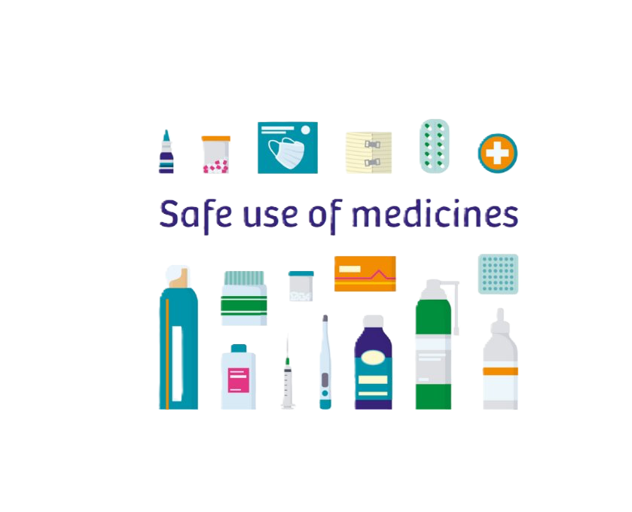
Welcome
This presentation is designed to help you understand essential health and safety information.
We'll cover important topics like what medicines to keep at home, when to go to the emergency room, and how to keep children safe from dangerous substances."

Slide 3
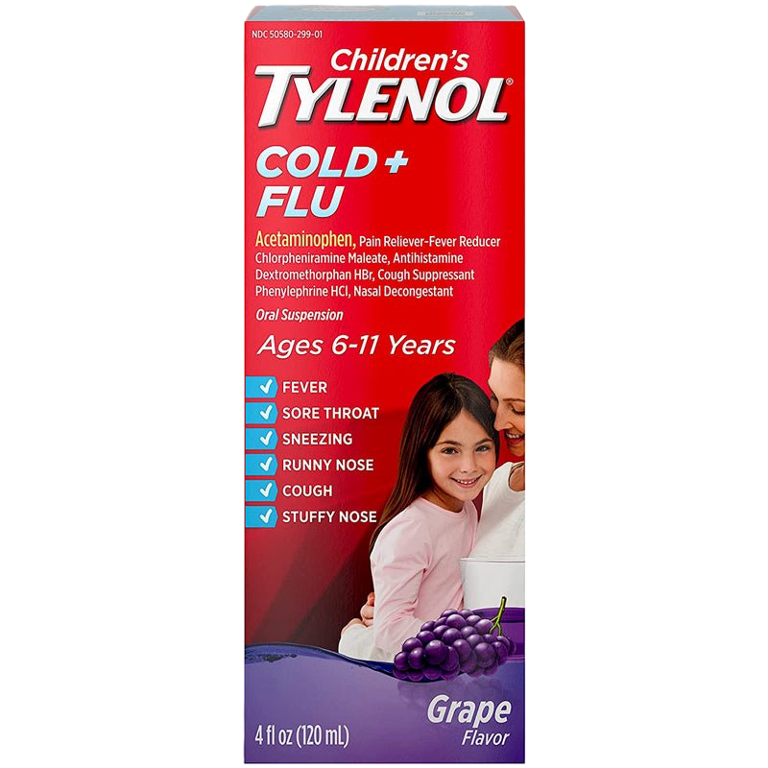
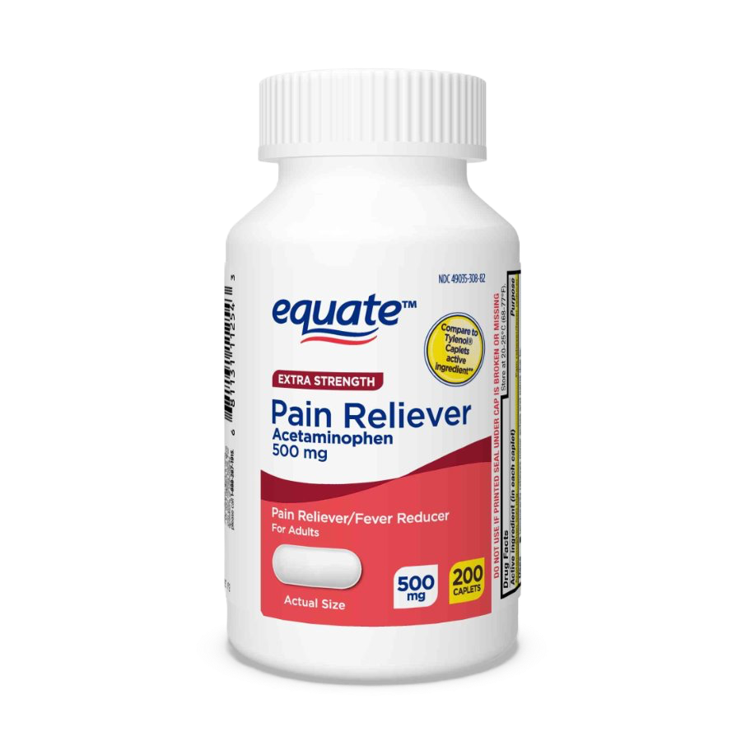
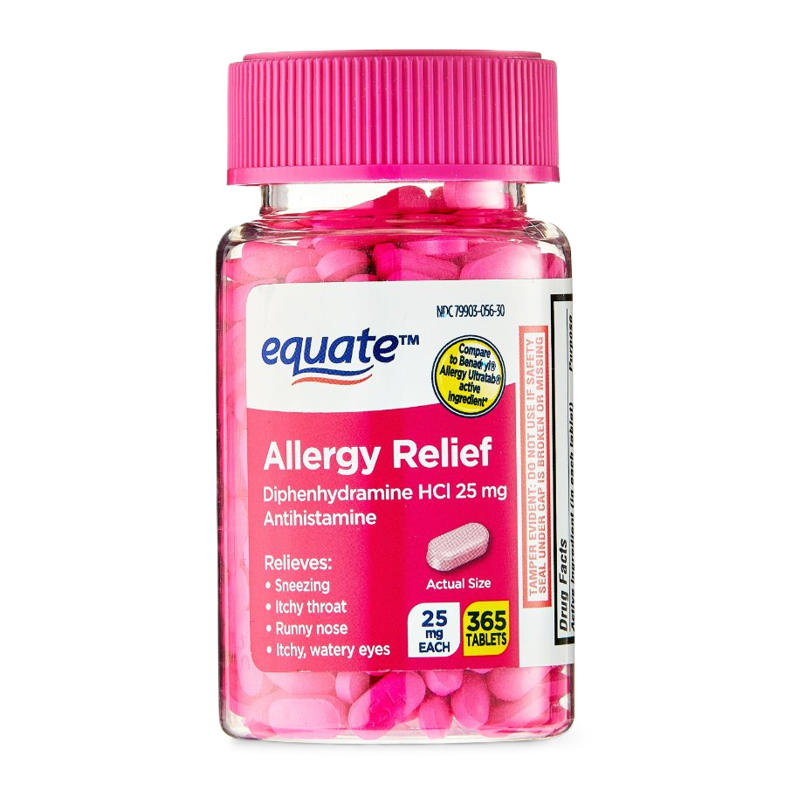
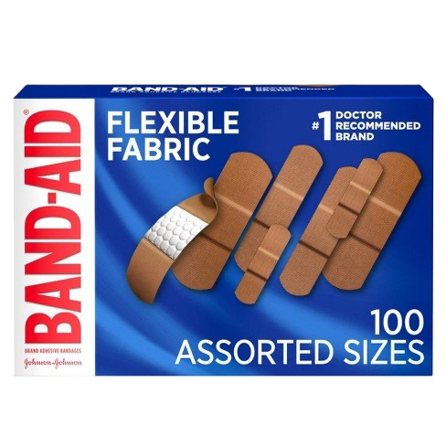
Medicines to keep at home
Pain relievers (e.g., acetaminophen, ibuprofen)
Antihistamines for allergies
Cough and cold medicines
Basic first aid kit (bandages, antiseptic, gauze, etc.)
Prescription medications (keep a list)
Notes:
Pain Relievers:
"Keep common pain relievers like acetaminophen (Tylenol) and ibuprofen (Advil, Motrin) for headaches, muscle pain, and fever."
Antihistamines:
"Useful for allergies, keep medications like diphenhydramine (Benadryl) and loratadine (Claritin)."
Cough and Cold Medicines:
"Have medicines like dextromethorphan for coughs and pseudoephedrine for nasal congestion."
First Aid Kit:
"Include bandages, antiseptic wipes, gauze pads, tweezers, and a thermometer."
Prescription Medications:
"Ensure you have an adequate supply of any prescription medications you take regularly. Keep a list of these medications."

Slide 4
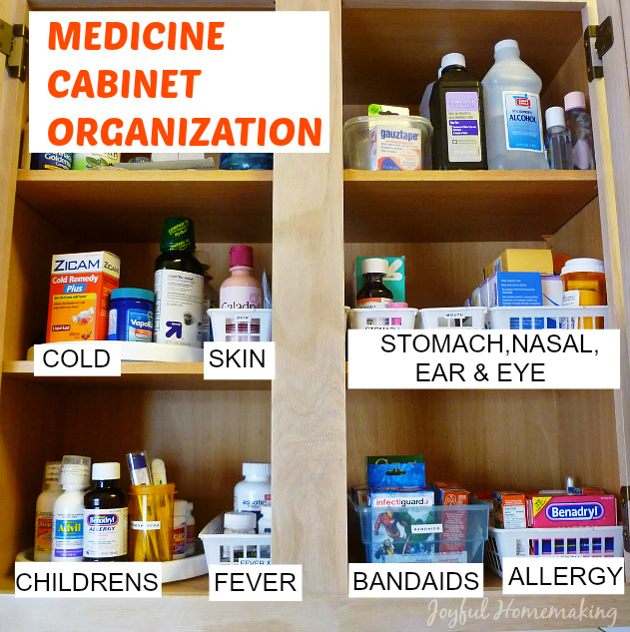
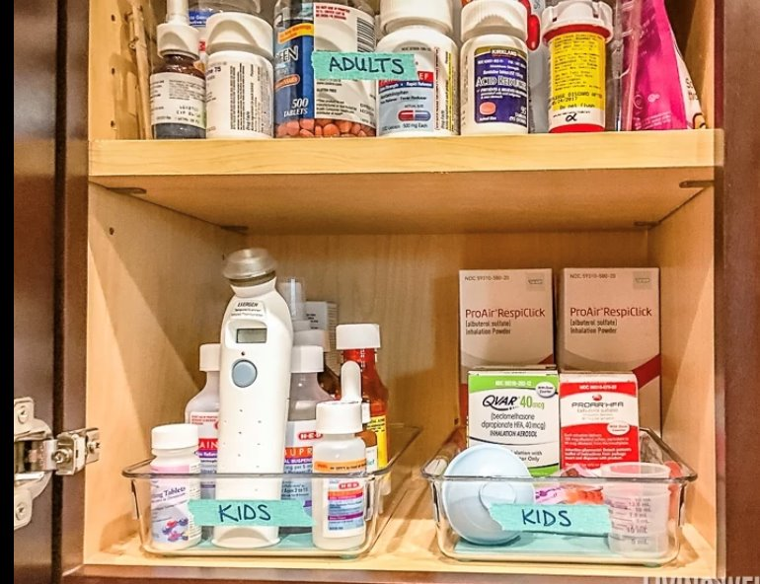
Proper Medication use & storage
Follow dosage instructions carefully
Do not share medications
Store medications in a cool, dry place
Check expiration dates

Slide 5
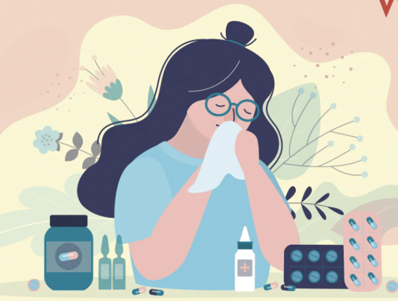
Possible side effects
Mild Reactions:
  Headache, Nausea, Drowsiness, Dizziness, Upset stomach
Severe Reactions:
  Difficulty breathing, Swelling of face, lips, or tongue, Severe rash or hives, Chest pain, High fever
  If you experience mild side effects:
  Monitor your symptoms
  Consult with your pharmacist or doctor if symptoms persist
If you experience severe side effects:
  Stop taking the medication immediately
  Seek medical help right away
  Call emergency services if necessary

Slide 6
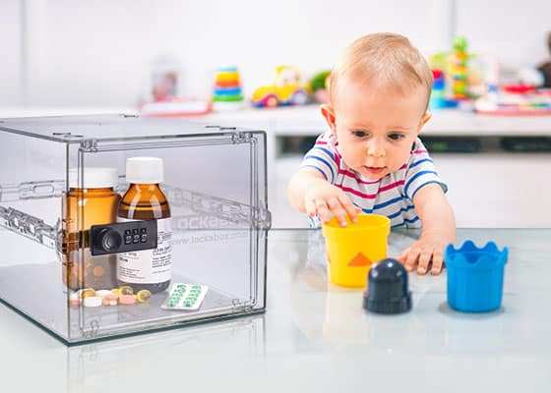
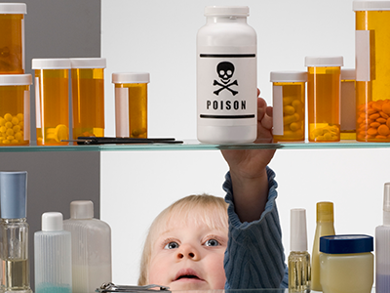
Keep your children safe
Store cleaning products and medicine out of reach
Teach children about the dangers
Keep products in original containers with their labels
Use child-proof locks on cabinets where cleaning products are stored.

Slide 7
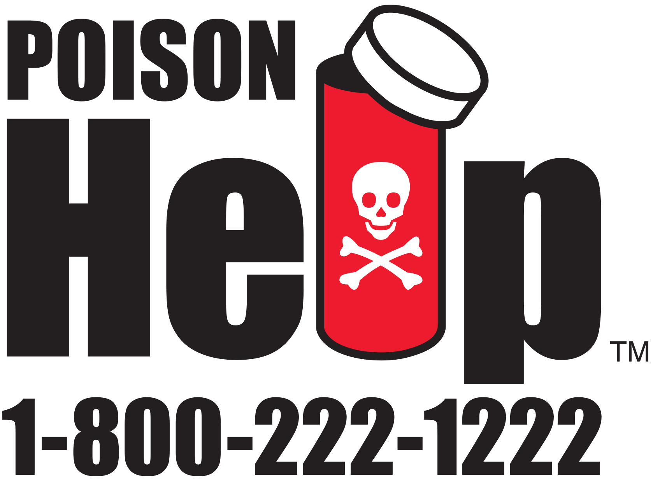
Recognizing poisonous items
Common Household Poisons:
  Cleaners, medications, certain plants, and chemicals.
Symptoms of Poisoning:
  Vomiting, dizziness, difficulty breathing, confusion.
Immediate Actions:
  If poisoning is suspected, call poison control immediately.
  Do not induce vomiting unless instructed by a professional.

Slide 8

When to go to the emergency room
Severe chest pain or difficulty breathing
Uncontrolled bleeding
Sudden weakness or numbness
Severe allergic reactions
High fever not responding to medication
Notes:
Severe Chest Pain:
"Could be a sign of a heart attack; seek immediate help."
Difficulty Breathing:
"Especially if sudden or severe; could indicate a serious condition."
Uncontrolled Bleeding:
"Heavy bleeding that doesn't stop with pressure requires emergency care."
Sudden Weakness or Numbness:
"Particularly if on one side of the body; may be a stroke."
High Fever Not Responding to Medication:
"Especially in young children or if accompanied by other severe symptoms."

Slide 9
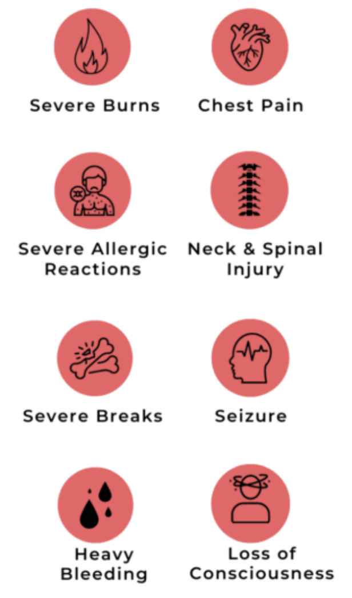
Doctors' office or Emergency room
Doctor Visits:
  "For non-urgent care like check-ups, mild infections, and chronic conditions."
Emergency Room:
  "For life-threatening situations or severe symptoms that need immediate attention."
  Example Situations:
"Doctor Visit: Mild fever, ear infection, minor injuries."
"Emergency Room: Severe chest pain, major injury, difficulty breathing."

Slide 10
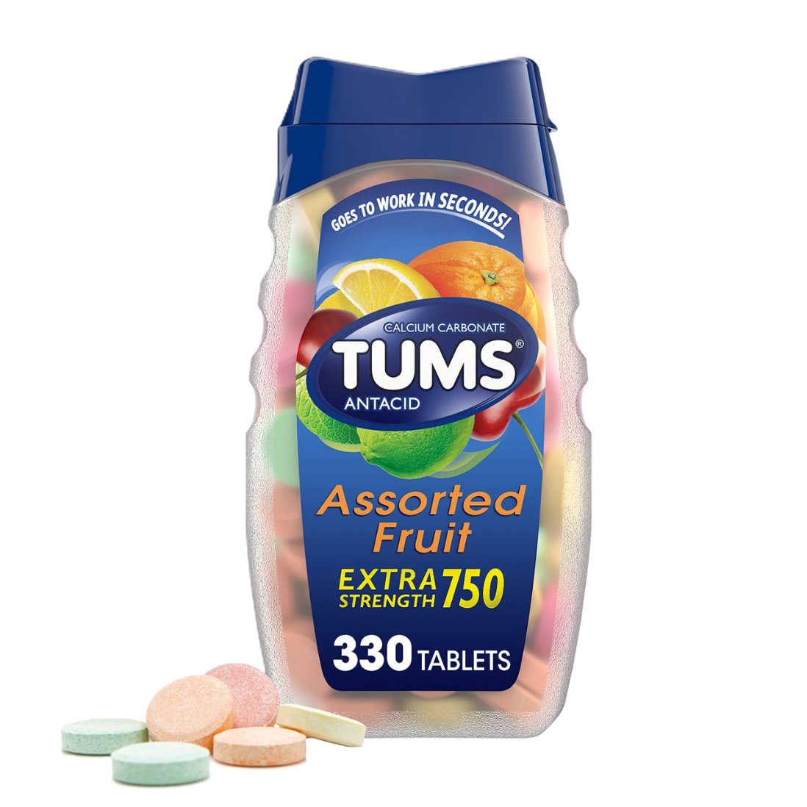
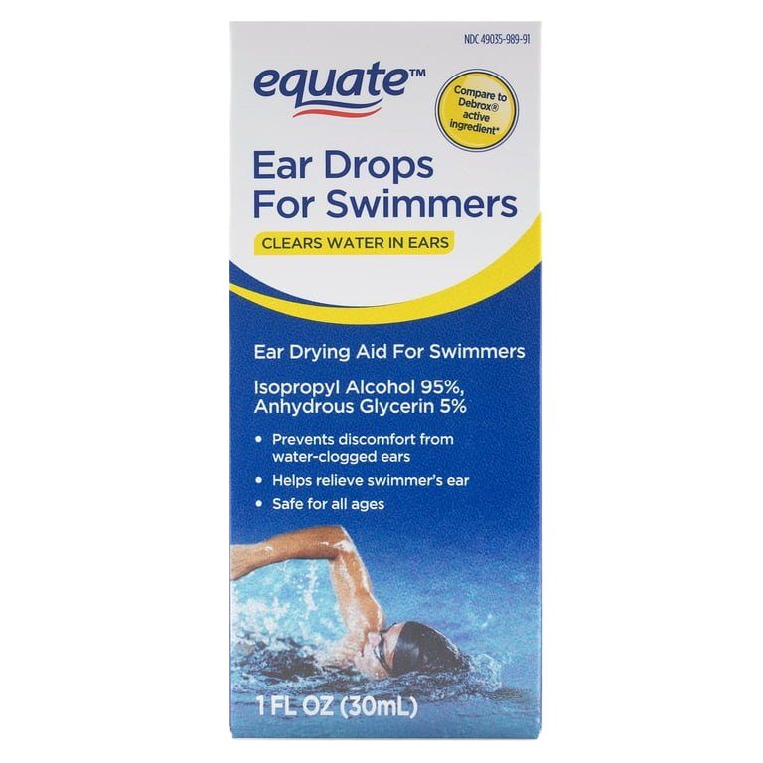
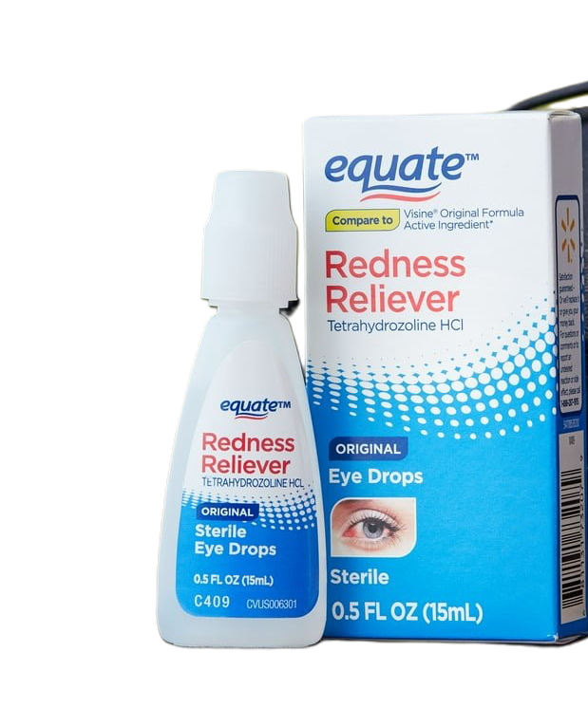
Things to buy

Slide 11
Thank you
Address: 517 E 26th St, Erie, PA 16504
Phone: (814) 452-3935

