Slide 1
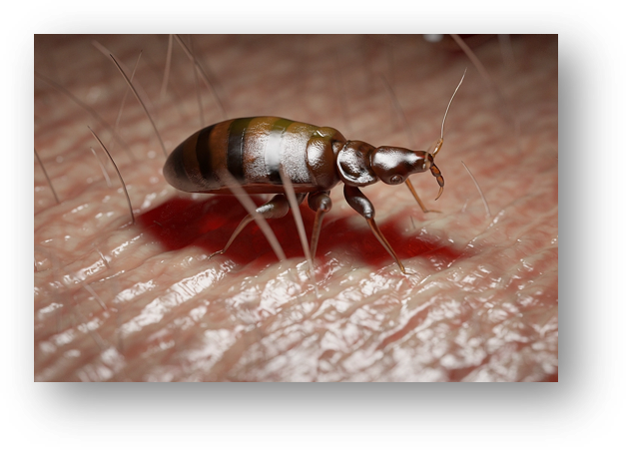
BED BUGS & HOW TO GET RID OF THEM
July 2025

Slide 2
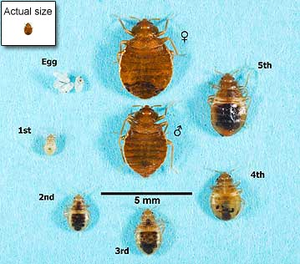
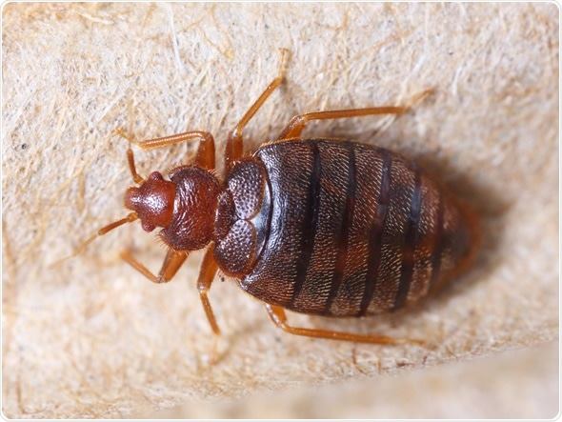
What are bed bugs
2
Bed bugs are small, flat insects. They bite people and animals at night while they sleep, feeding on their blood.
Bed bugs are reddish-brown in color, are wingless, and range from 1mm to 7mm in size.
They do not fly or jump, but they can crawl rapidly.

Slide 3
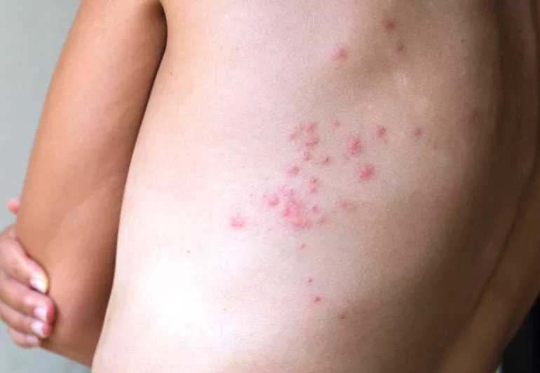
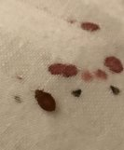
Signs of bed bugs
When cleaning, changing bedding, or staying away from home, look for:
Rusty or reddish stains on bed sheets or mattresses caused by bed bugs being crushed.
Dark spots (about this size: •), which are bed bug excrement and may bleed on the fabric like a marker would.
Eggs and eggshells, which are tiny (about 1mm) and pale yellow skins that nymphs shed as they grow larger.
Live bed bugs.

Slide 4
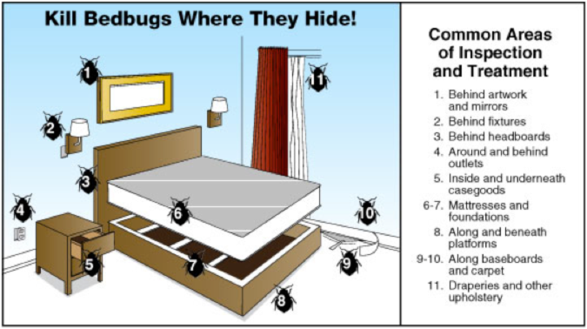
Where bed bugs hide
Around the bed, they can be found near the piping, seams and tags of the mattress and box spring, and in cracks on the bed frame and headboard.
You may also find bed bugs in
Seams of chairs and couches, between cushions, and in the folds of curtains.
In drawer joints.
Under loose wallpaper

Slide 5
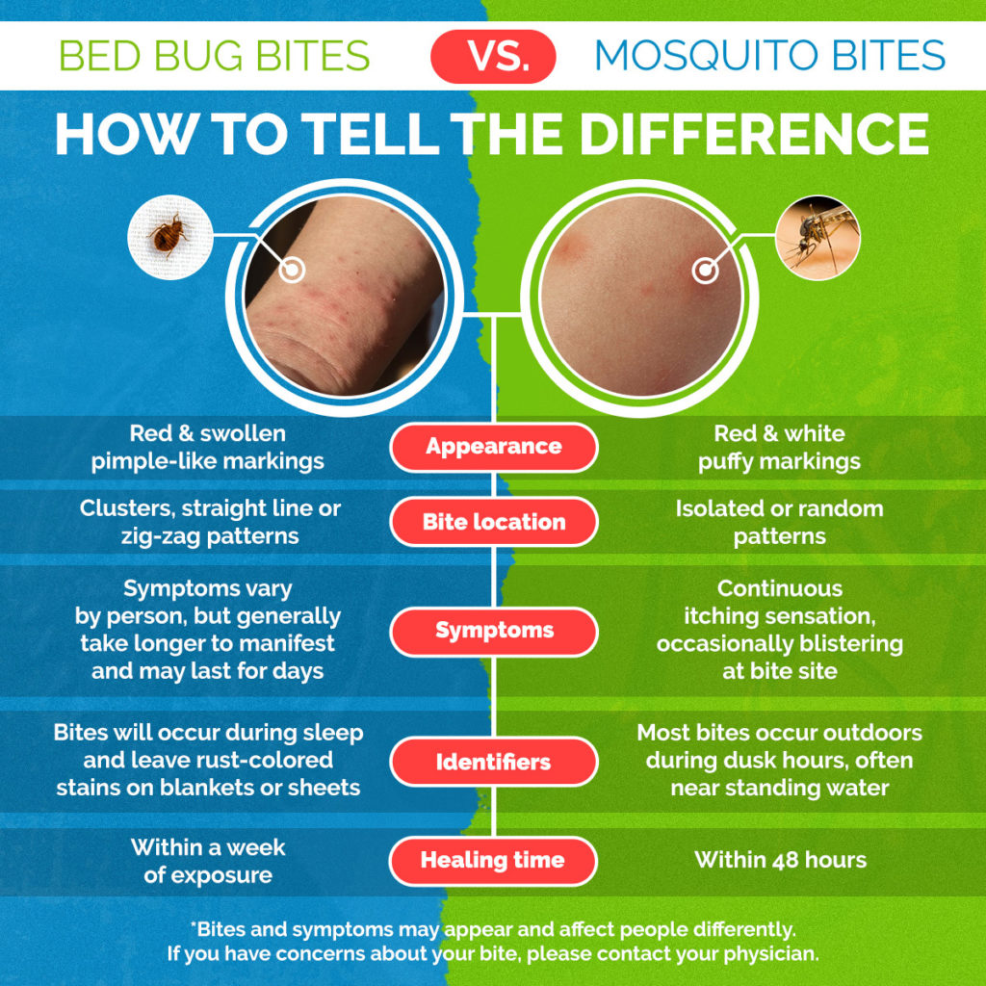
How to tell if you've been bitten
Bed bug bites affect each person differently. Signs of a bed bug bites include:
No physical signs
Small bite marks
Serious allergic reactions (rare).
When bed bugs bite, they inject fluids that prevents a person from feeling the bite when it happens. Most people do not notice the bite marks until they appear from one to several days after the initial bite.
Bites look similar to mosquito or flea bites—a slightly swollen and red area that may itch and be irritating. The bite marks may be random or appear in a straight line.

Slide 6
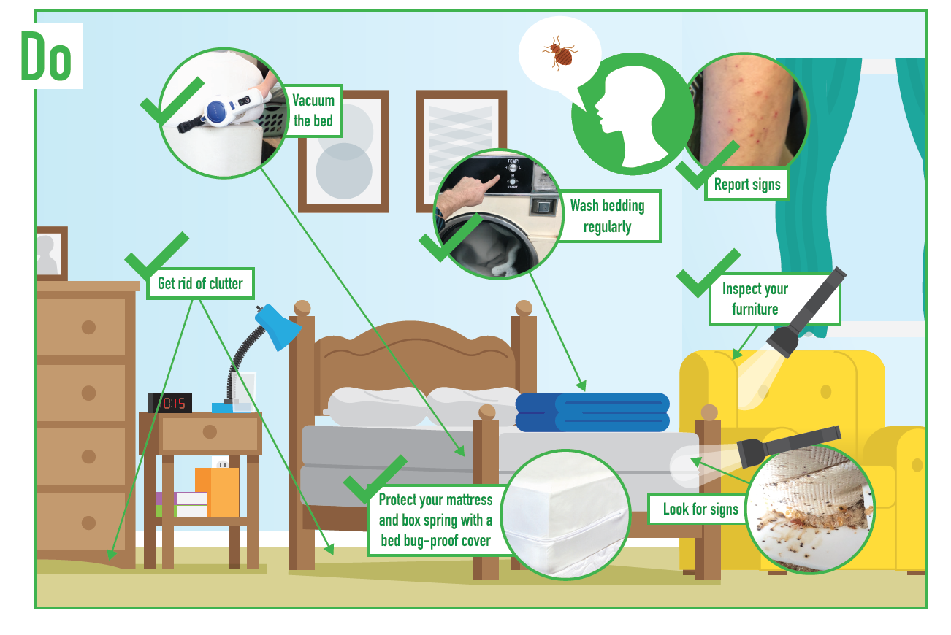
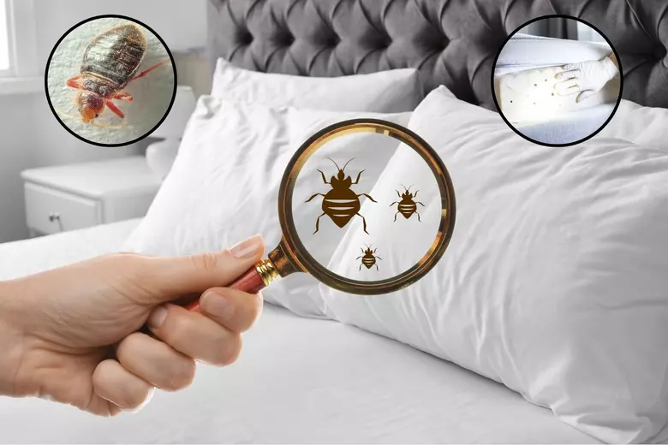
Preventing bed bugs
6
Bed bugs are great hitchhikers. They can move from an infested site to a new home by traveling on furniture, bedding, luggage, boxes and clothing.
Check secondhand furniture, beds and couches for any signs of bed bug infestation before bringing them home.
Regularly wash and heat-dry your bed sheets, blankets, bedspreads and any clothing that touches the floor.
Carefully vacuum rugs, floors, upholstered furniture, bed frames, under beds, around bed legs, and all cracks and crevices around the room. Change the bag after each use so the bed bugs can’t escape

Slide 7
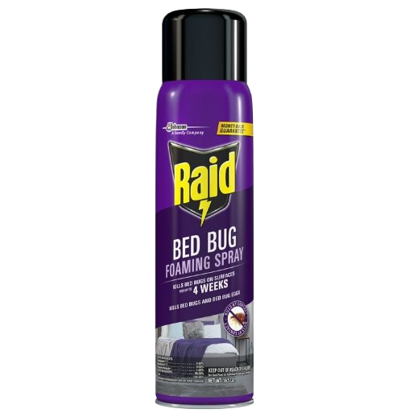
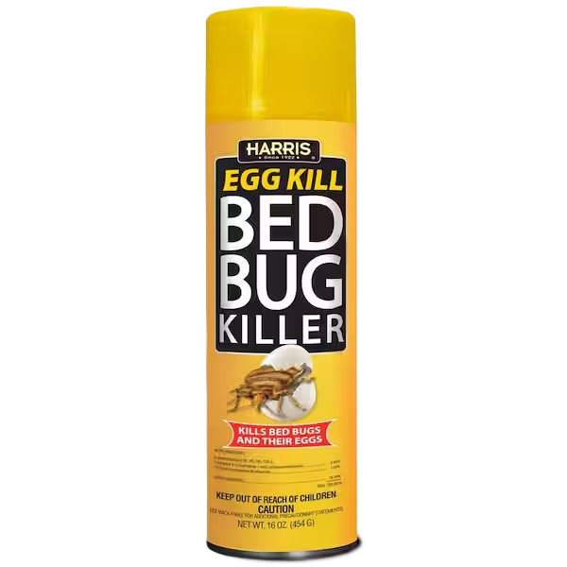

How to get rid of bed bugs
There are both chemical and non-chemical approaches are available. While using one or the other works, an approach that uses a combination of both can be the most effective.
Chemical approaches include pesticides that may be purchased at Walmart and sprayed onto infested surfaces.
Non-Chemical approaches include sealing small hiding places, removing infested items in sealed plastic bags, and vacuuming frequently.
Additionally, placing infested items into the dryer on high heat can help eliminate bed bugs.
If at home methods are unsuccessful, please contact a professional for assistance.

Slide 8




Local Companies who can help
8
Big Foot Pest Control
(814)-899-8278
Expert Pest Management
(814)-454-1377
Ehrlich
(814)-414-4188
For more information visit this website:
https://www.epa.gov/bedbugs
Or watch this video:
https://www.youtube.com/watch?v=f93ObuVJHAE

Slide 9
Thank you
Phone: 814-452-3935
Email: info@uscri-erie.org
Website: https://refugees.org/uscri-erie/

