Slide 1

Men's hygiene practices
July, 2024

Slide 2

Introduction
Importance of Hygiene:
  Disease Prevention: Proper hygiene helps prevent the spread of diseases and infections.
  Physical Well-being: Regular hygiene practices maintain overall physical health and comfort.
  Mental Health: Good hygiene can improve self-esteem and mental well-being.
Topics Covered:
The main topics that will be covered in the presentation, are daily hygiene routines, showering, oral hygiene, and hand washing.

Slide 3
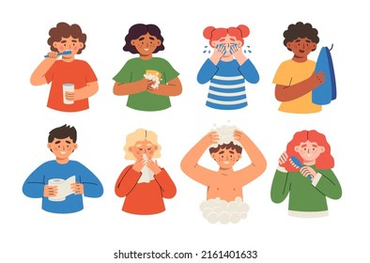
Understanding Hygiene
What is personal hygiene?
Personal hygiene is the practices and habits that you perform to maintain cleanliness and care for your body, ensuring health and well-being.
Daily Hygiene Routine
  Showering or bathing
  Brushing teeth
  Deodorant use
  Hand washing

Slide 4

Showering and Bathing
Frequency Recommendation: Shower or bathe at least once a day or as needed, especially after sweating or engaging in physical activities.
Products
Soap: Use a mild soap or body wash suitable for your skin type.
Shampoo: Choose a shampoo that suits your hair type (e.g., oily, dry, normal).
Conditioner: Optional, but beneficial for those with dry or long hair to keep it manageable and healthy.
Additional Products: Consider using a loofah or washcloth to exfoliate and remove dead skin cells.

Slide 5
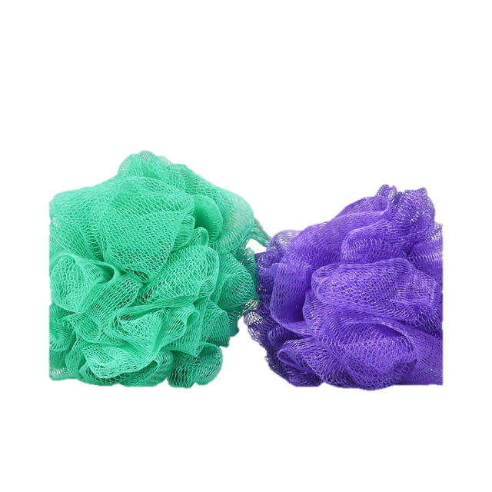
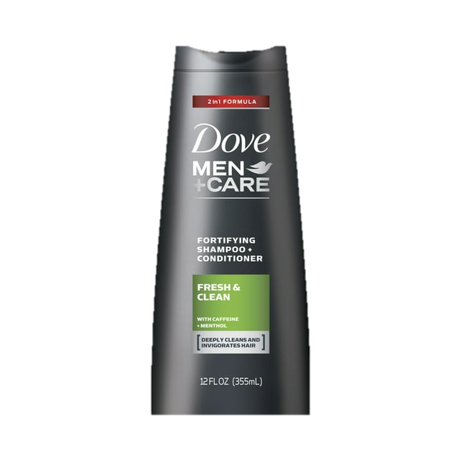
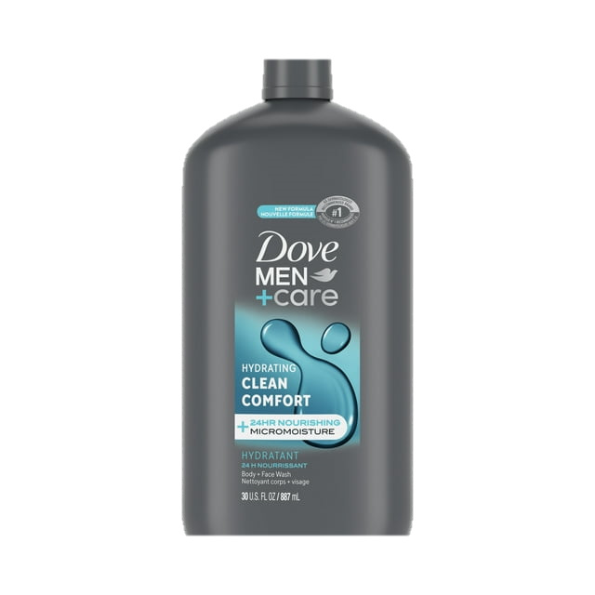
Showering and Bathing
Step-by-Step Guide:
  Wet Your Body: Use warm water to thoroughly wet your body.
  Apply Soap: Lather soap or body wash in your hands or on a washcloth/loofah.
  Wash: Gently scrub your entire body, paying attention to areas prone to sweat and odor (e.g., underarms, feet, groin).
  Rinse: Rinse off all soap thoroughly to prevent skin irritation.
  Shampoo and Condition: Apply shampoo to your hair, lather, and rinse. Follow with conditioner if needed.
  Dry: Pat yourself dry with a clean towel to avoid skin irritation. Ensure areas prone to moisture (e.g., underarms, groin) are thoroughly dried.
  Moisturize: Apply a moisturizer after showering to keep your skin hydrated.

Slide 6

Intimate hygiene
Technique:
Water and Mild Soap:
  Use lukewarm water to wash the genital area daily.
  Use a mild, unscented soap. Avoid harsh or scented products, as they can cause irritation.
Method:
  Gently wash the entire genital area. If uncircumcised, gently retract wash underneath
  Rinse thoroughly to remove all soap residue.
  Drying:
Pat the area dry with a clean, soft towel.
Ensure the area is completely dry to prevent bacterial growth

Slide 7
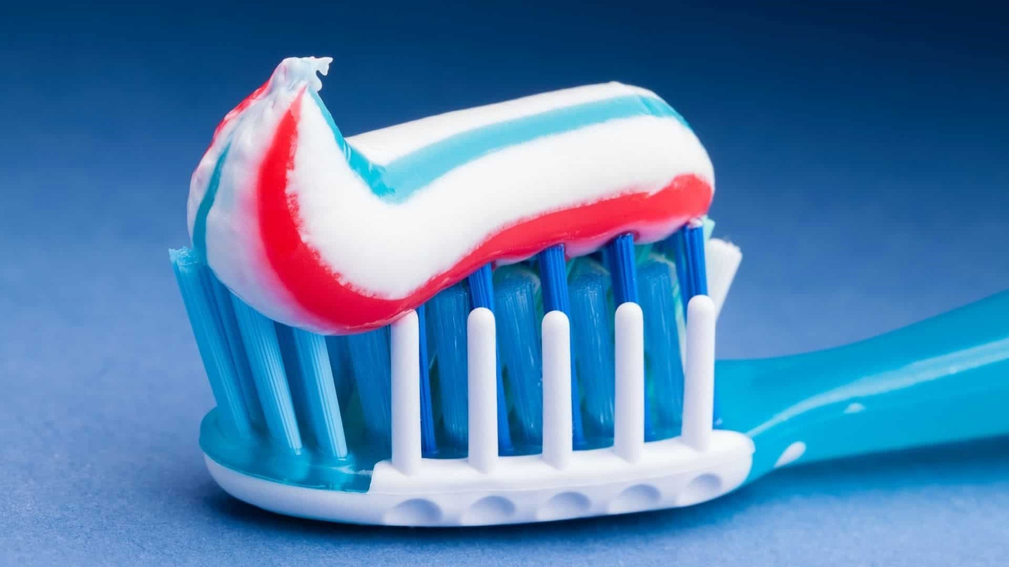
Oral Hygiene
Frequency
Brushing: Brush your teeth at least twice a day, ideally in the morning and before bedtime.
Flossing: Floss daily to remove food particles and plaque between teeth.
Mouthwash: Use an antibacterial mouthwash once a day to help reduce bacteria and freshen breath.
Products
Toothbrush: Use a soft-bristled toothbrush. Replace it every 3-4 months or sooner if the bristles are frayed.
Toothpaste

Slide 8
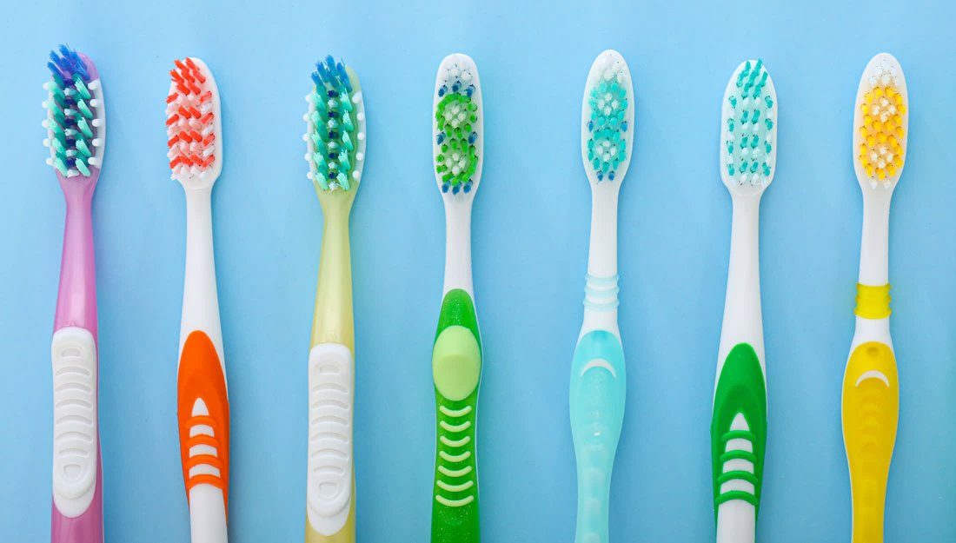
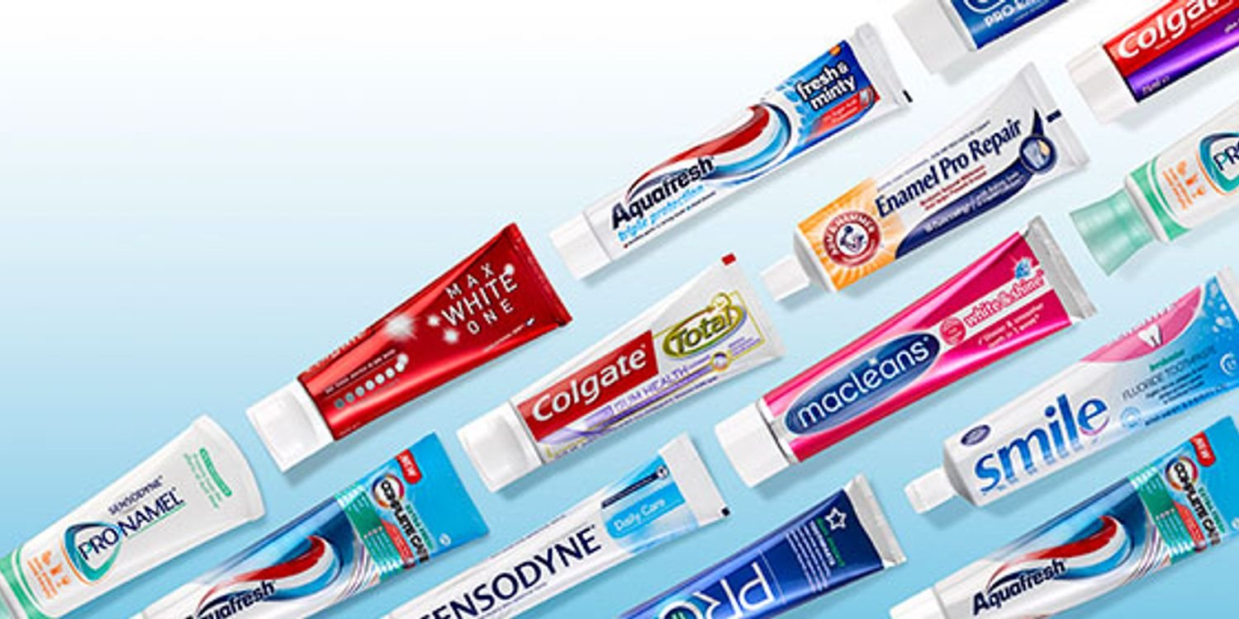
Oral Hygiene
Technique
Brushing Steps:
  Apply Toothpaste: Squeeze a pea-sized amount of toothpaste onto your toothbrush.
  Angle the Brush: Hold the toothbrush at a 45-degree angle to your gums.
  Brush: Use gentle, circular motions to brush all surfaces of your teeth: outer, inner, and chewing surfaces.
  Duration: Brush for at least two minutes.
  Tongue Cleaning: Gently brush your tongue or use a tongue scraper to remove bacteria and freshen breath.
  Rinse: Rinse your mouth and toothbrush thoroughly with water.

Slide 9
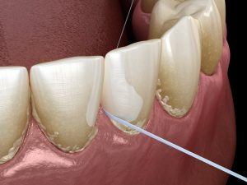
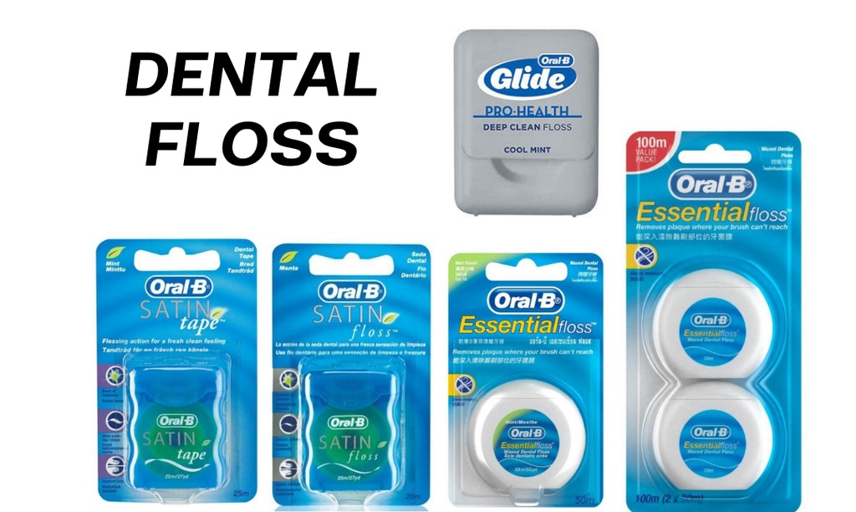
Oral Hygiene
Flossing Steps:
Use Enough Floss: Cut about 18 inches of floss.
Hold the Floss: Wrap the ends around your middle fingers, leaving about 1-2 inches to work with.
Guide the Floss: Gently slide the floss between your teeth using a back-and-forth motion.
Curve the Floss: Curve the floss around each tooth and gently slide it under the gumline.
Move to a Clean Section: Use a clean section of floss for each tooth.

Slide 10
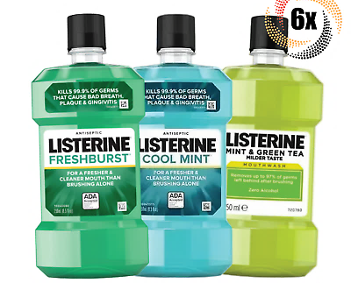
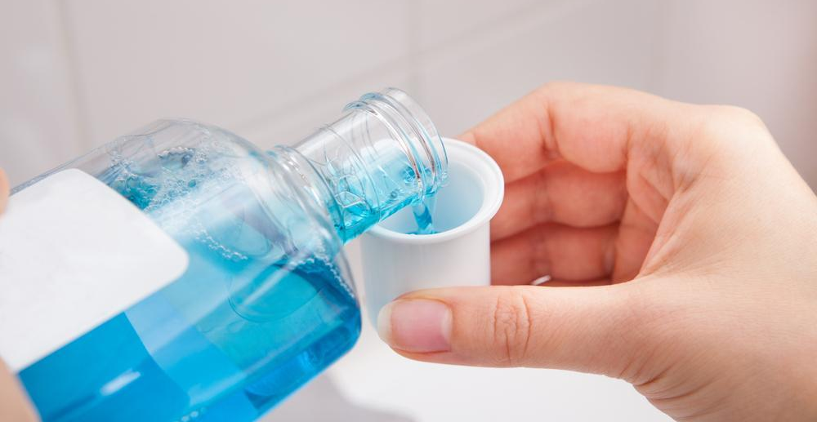
Oral Hygiene
Mouthwash Steps:
Measure: Pour the recommended amount of mouthwash into a cup.
Rinse: Swish it around your mouth for 30-60 seconds.
Spit Out: Do not swallow the mouthwash.

Slide 11
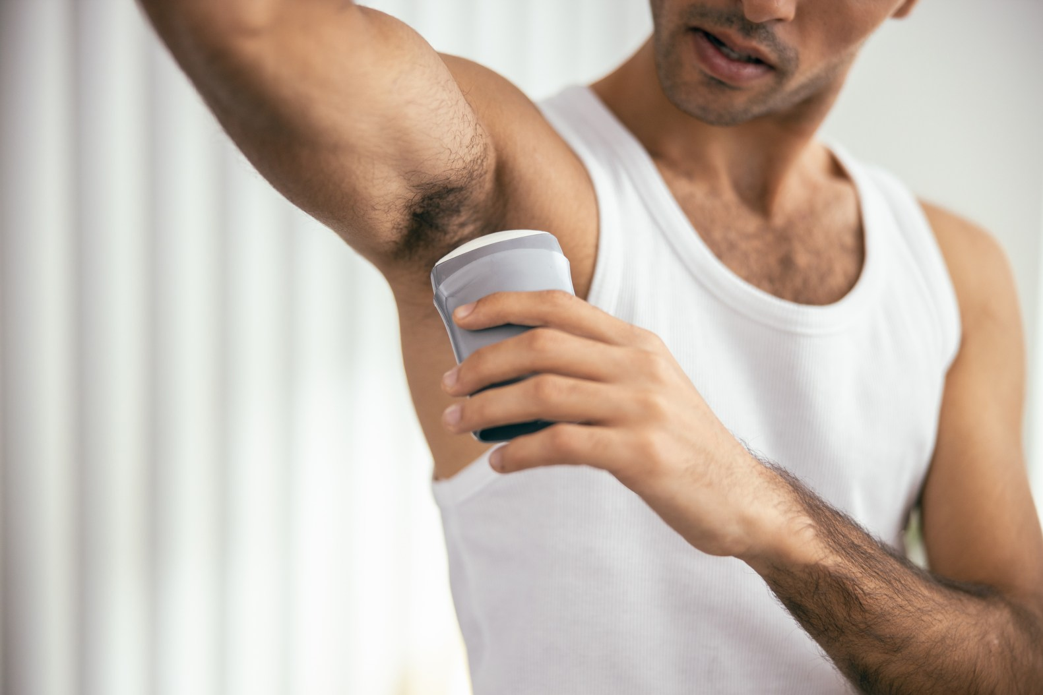
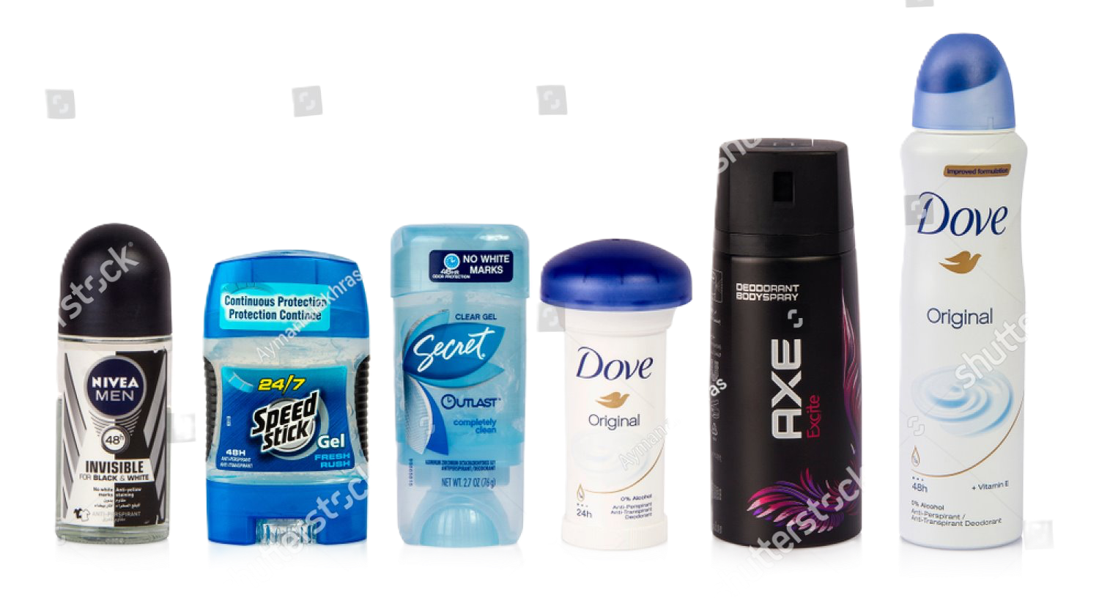
Deodorant and Antiperspirant
Purpose
Preventing Body Odor: Deodorants mask or neutralize body odor caused by sweat and bacteria.
  Forms: Roll-on, stick, spray, gel, and cream.
Controlling Sweat: Antiperspirants reduce the amount of sweat produced by blocking sweat glands.
  Similar to deodorants – roll-on, stick, spray, gel, and cream.

Slide 12
Deodorant and Antiperspirant
Application
When to Apply: Best applied to clean, dry skin. Ideally, apply after showering and drying off.
How to Apply:
  Roll-on and Stick: Glide over underarms evenly. Ensure full coverage but avoid over-application to prevent residue.
  Spray: Hold the can 6 inches away from the underarm and spray for 2-3 seconds.
  Gel and Cream: Squeeze a small amount and rub it into the underarm area until fully absorbed.
Frequency: Apply once or twice a day, depending on individual needs and activity levels.

Slide 13

Hand Hygiene
Disease Prevention: Proper hand hygiene is the most effective way to prevent the spread of infections and illnesses.
Community Health: Reduces the transmission of germs to others, protecting both personal and public health.
Everyday Activities: Critical for maintaining hygiene after activities such as using the restroom, handling food, or coming into contact with potentially contaminated surfaces.

Slide 14
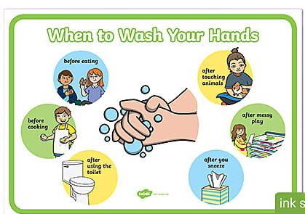
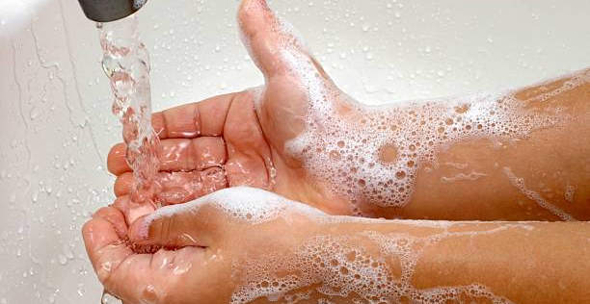
Hand Hygiene
Before:
Eating or preparing food
After:
Using the restroom
Handling raw meat, poultry, or fish
Touching garbage
Blowing your nose, coughing, or sneezing
Caring for someone who is sick
Changing diapers or cleaning up a child who has used the toilet
Handling pets or pet waste
Treating wounds or giving medicine
Touching a sick or injured person

Slide 15
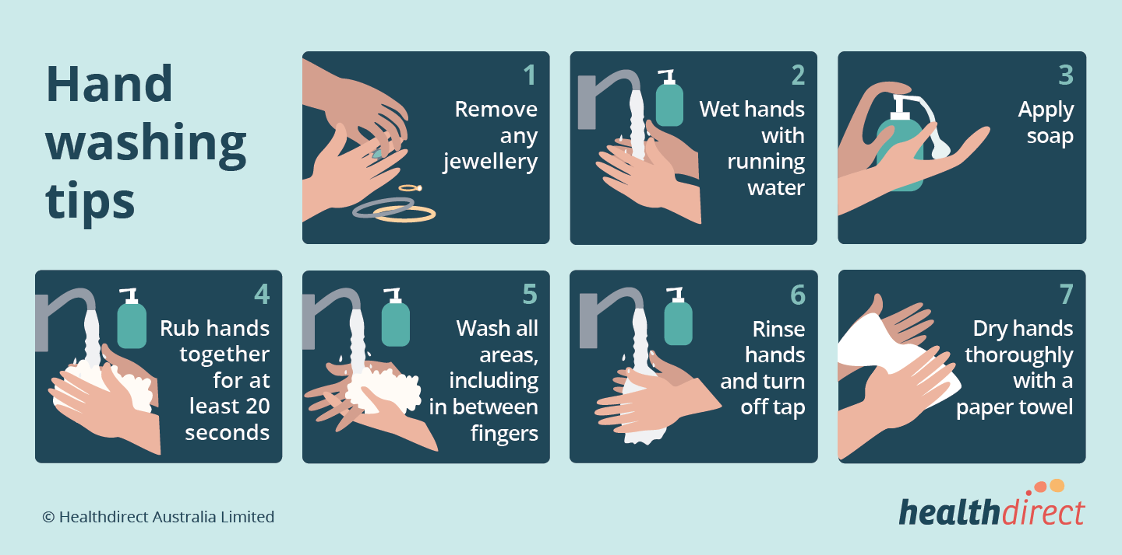
Hand Hygiene
Step-by-Step Guide:
  Wet Hands: Wet your hands with clean, running water (warm or cold), and apply soap.
  Lather: Rub your hands together to lather the soap. Make sure to lather the backs of your hands, between your fingers, and under your nails.
  Scrub: Scrub your hands for at least 20 seconds. Hum the "Happy Birthday" song from beginning to end twice for a time reference.
  Rinse: Rinse your hands well under clean, running water.
  Dry: Dry your hands using a clean towel or air dry them.

Slide 16
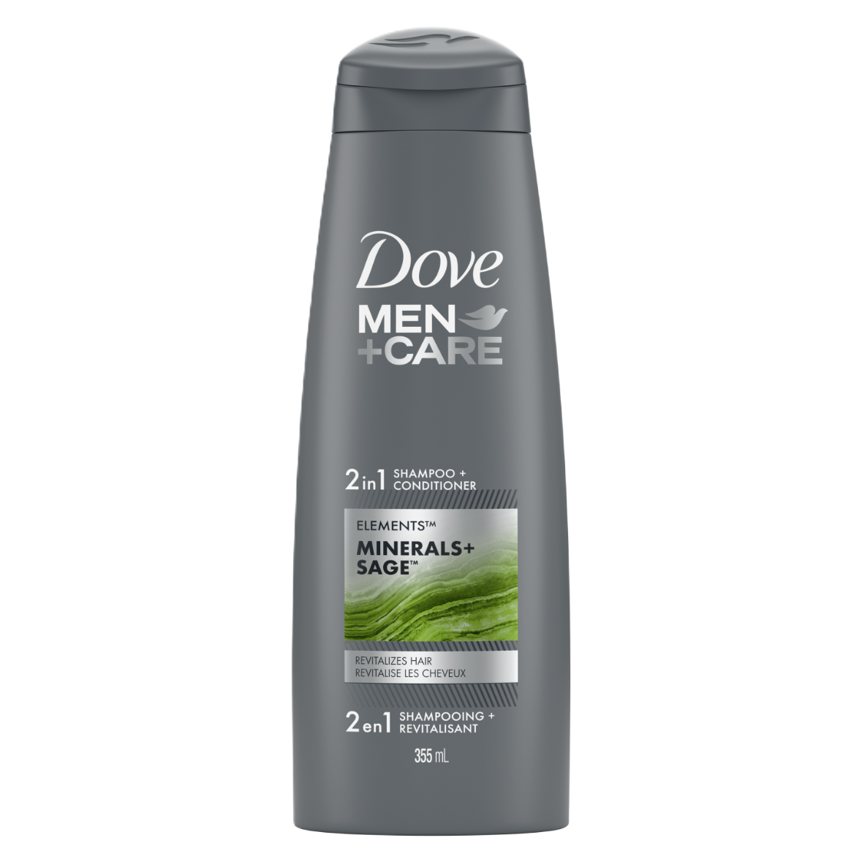
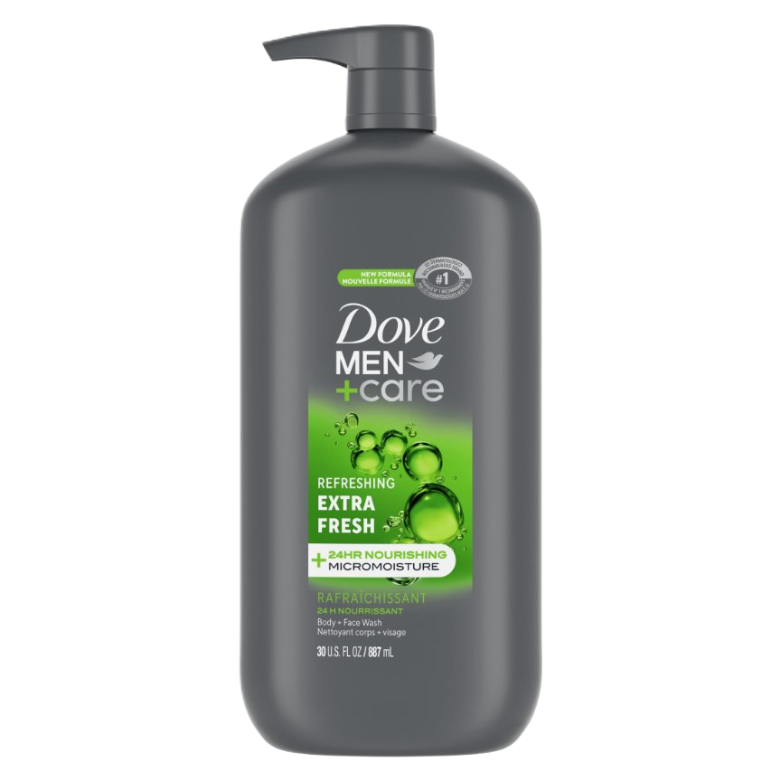
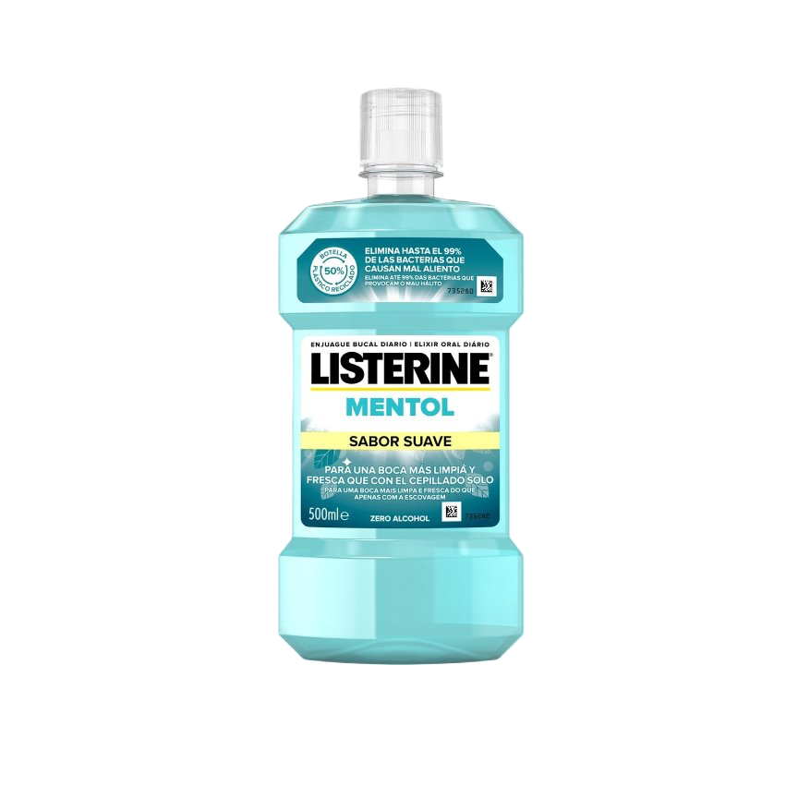
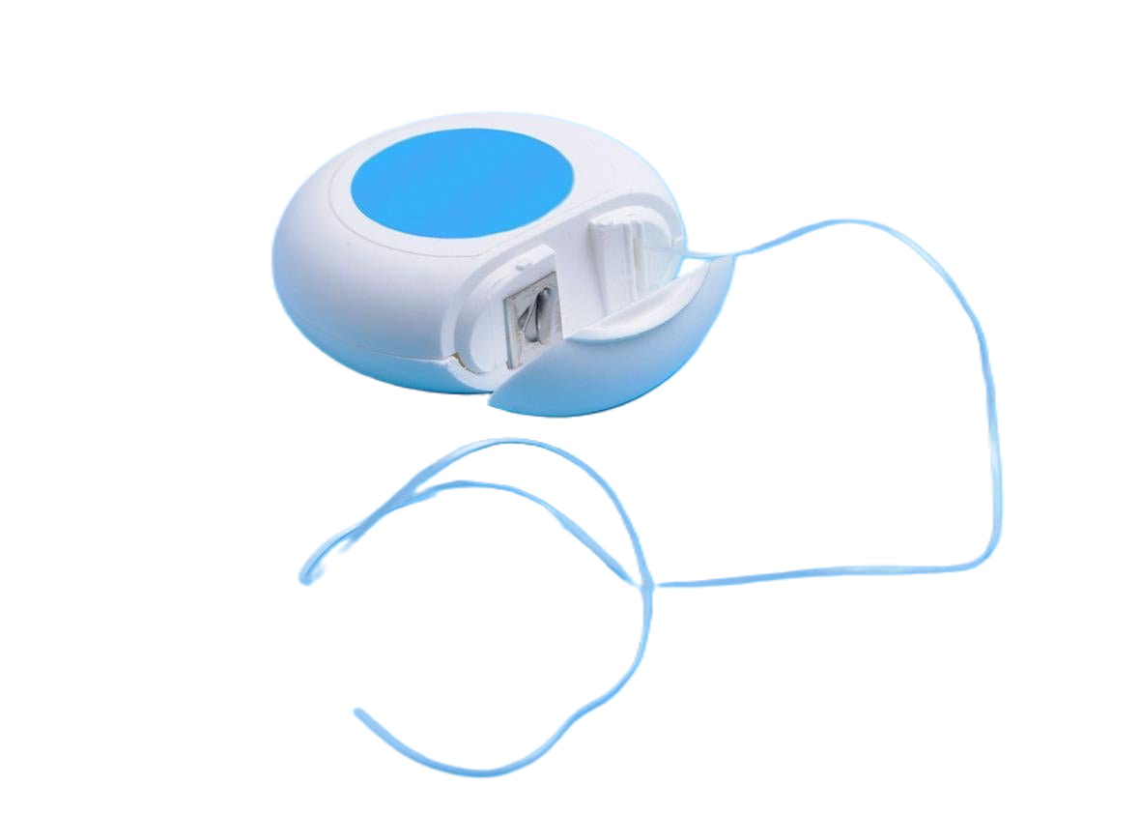
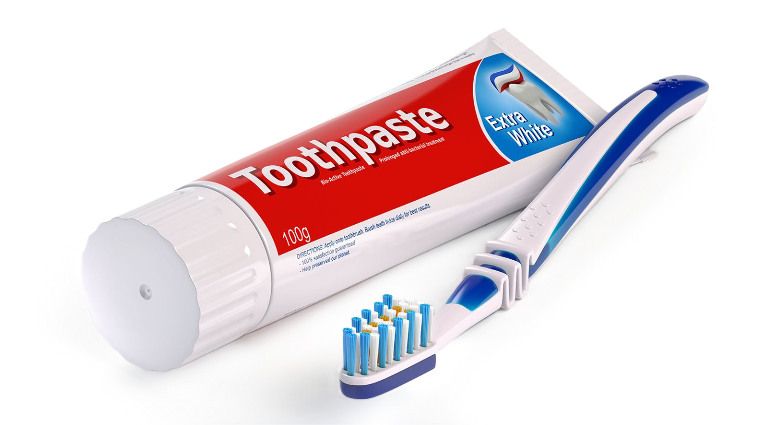
Things To Buy at the Store

Slide 17
Thank you!
Questions?
Address: 517 E 26th St, Erie, PA 16504
Phone: (814) 452-3935

