Slide 1

Pharmacy information
What is a Pharmacy and How to Use It

Slide 2

Welcome
This guide is designed to help you feel more confident and informed when visiting a pharmacy.
Notes:
"Welcome to our presentation on how to use a pharmacy and pick up your prescriptions."
"We understand that navigating healthcare can be challenging, especially in a new country and language."
"Understanding how to use a pharmacy is crucial for maintaining your health and the health of your family."
"Knowing how to pick up prescriptions, use medications correctly, and seek help when needed ensures better health outcomes."
"We aim to provide you with the knowledge and resources to make this process easier and safer for you."

Slide 3
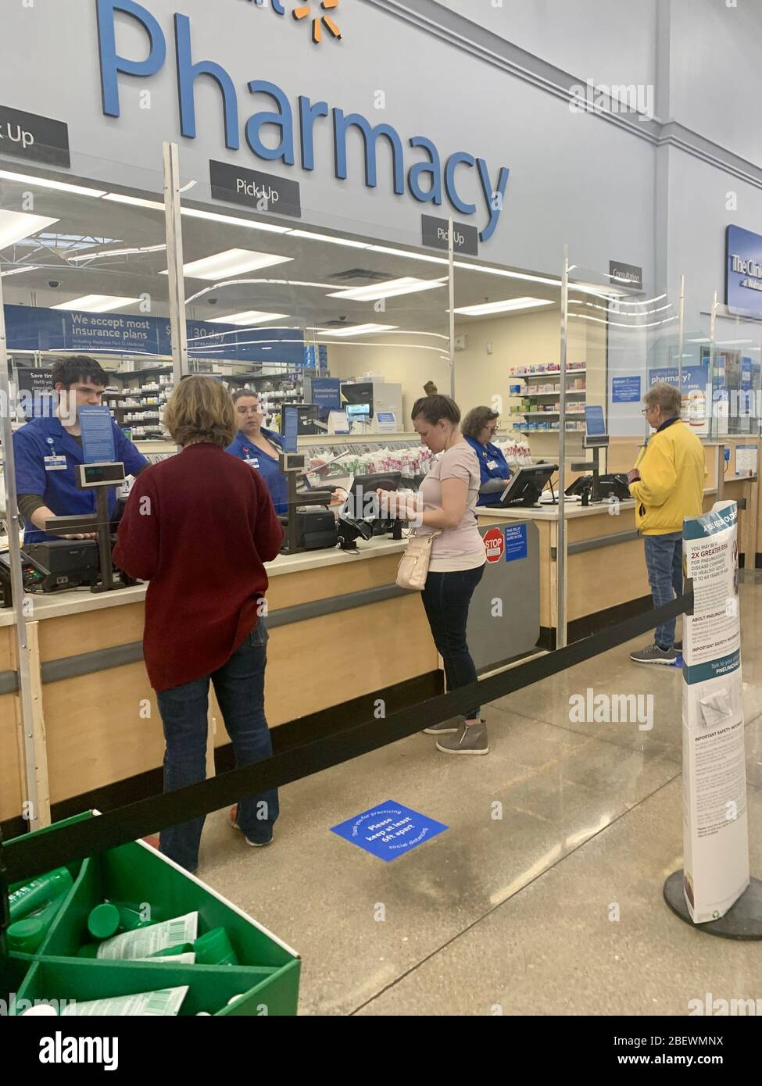
What is a pharmacy?
A place where medications are dispensed, and health advice is provided.
Services Provided:
  Dispensing prescribed medications
  Providing over-the-counter (OTC) medications
  Offering health advice and information
  Administering vaccinations and health screenings

Slide 4
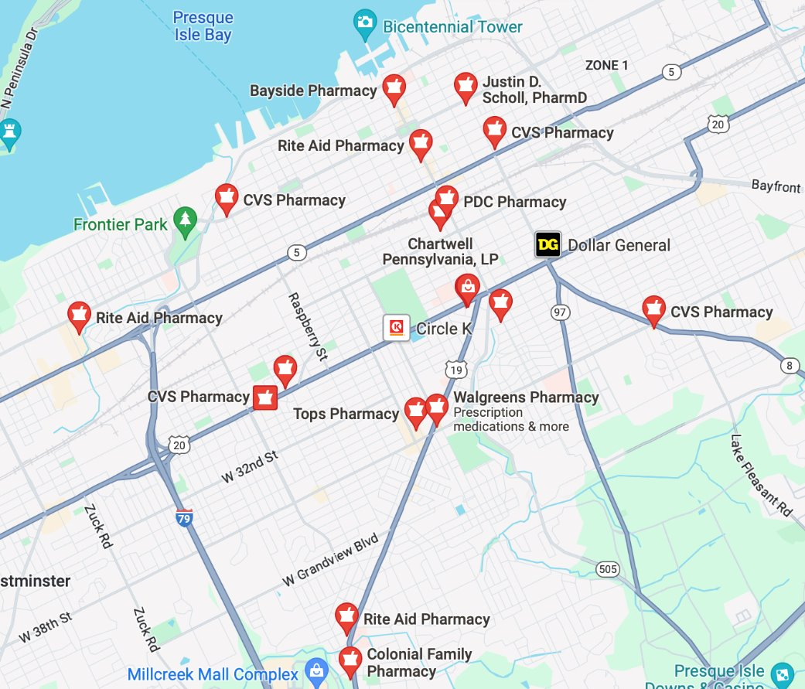
How to Find a pharmacy
Locate pharmacies in your area
Close to your house, within walking area

Slide 5
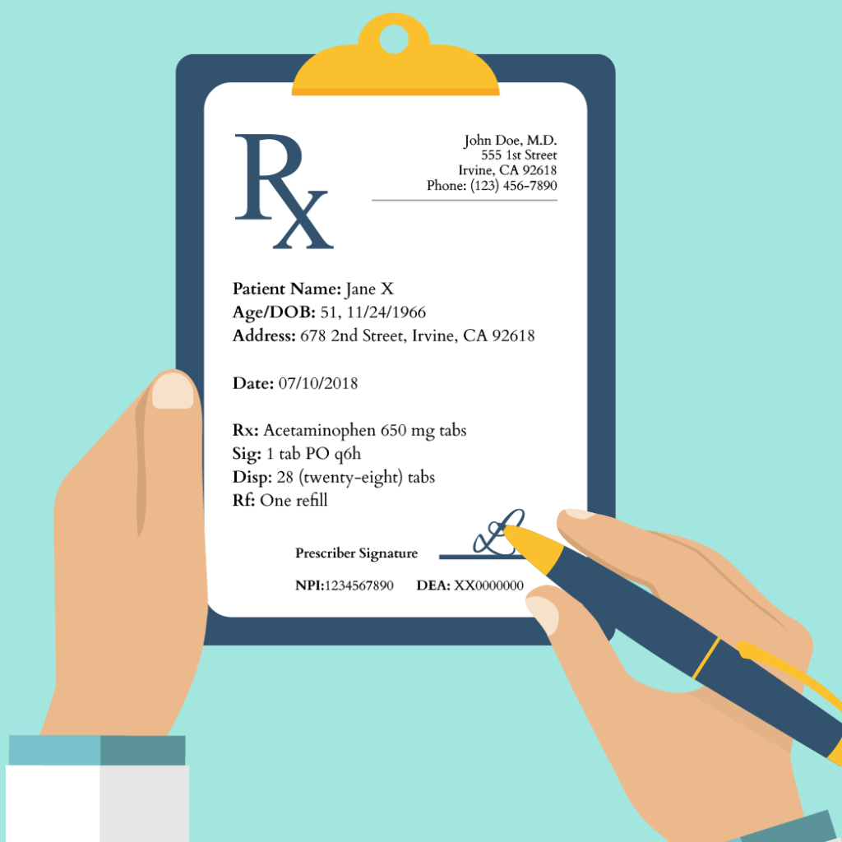
Prescriptions
What is a Prescription?: A document provided by a doctor that allows you to obtain medication.
Information on a Prescription:
  Doctor's name and contact information
  Patient's name
  Medication name and strength
  Dosage instructions
  Number of refills allowed
Importance: Ensuring you understand what the prescription is for and how to take the medication.

Slide 6
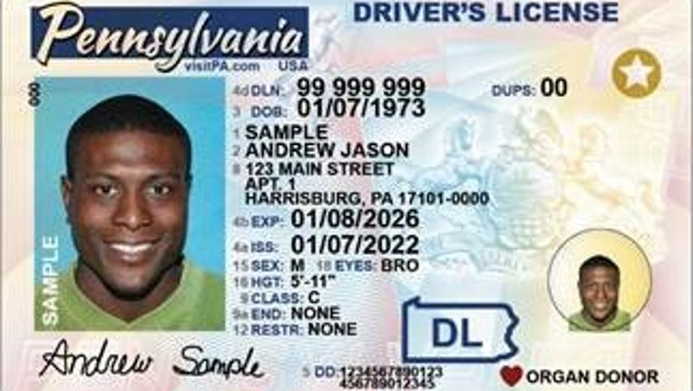
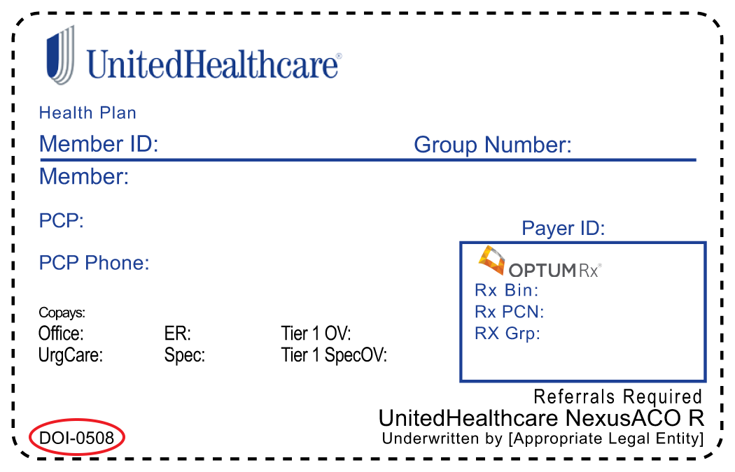
Visiting the pharmacy
What to Bring:
  Prescription from your doctor
  Identification (ID)
  Insurance card, if applicable
What to Say:
  Present the prescription to the pharmacist or pharmacy technician.
  Mention any allergies or medical conditions.
Language Support: Ask if translation services or multilingual staff are available.

Slide 7

Picking up prescription
Process:
  Wait time may vary; the pharmacist will tell you when your medication is ready.
  Present your ID and insurance card when picking up.
Verify Medication:
  Check the medication name and dosage.
  Ask the pharmacist to explain how to take the medication.
Payments: Understand how to pay, whether it's through insurance, cash, or other payment methods.

Slide 8
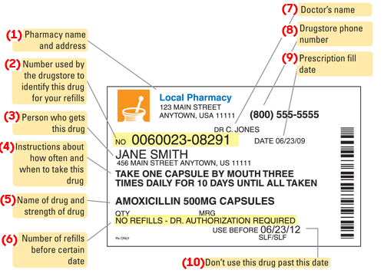
Medication label
Label Information:
  Medication name and strength
  Dosage instructions (how much and when to take)
  Warnings and side effects
  Storage instructions
Importance: Ensuring you take the medication correctly and safely.

Slide 9

Asking Questions
  What are the possible side effects?
  Can I take this medication with other medicines or supplements?
  How should I store this medication?
  What should I do if I miss a dose?
Importance: Understanding your medication to avoid any health risks.

Slide 10
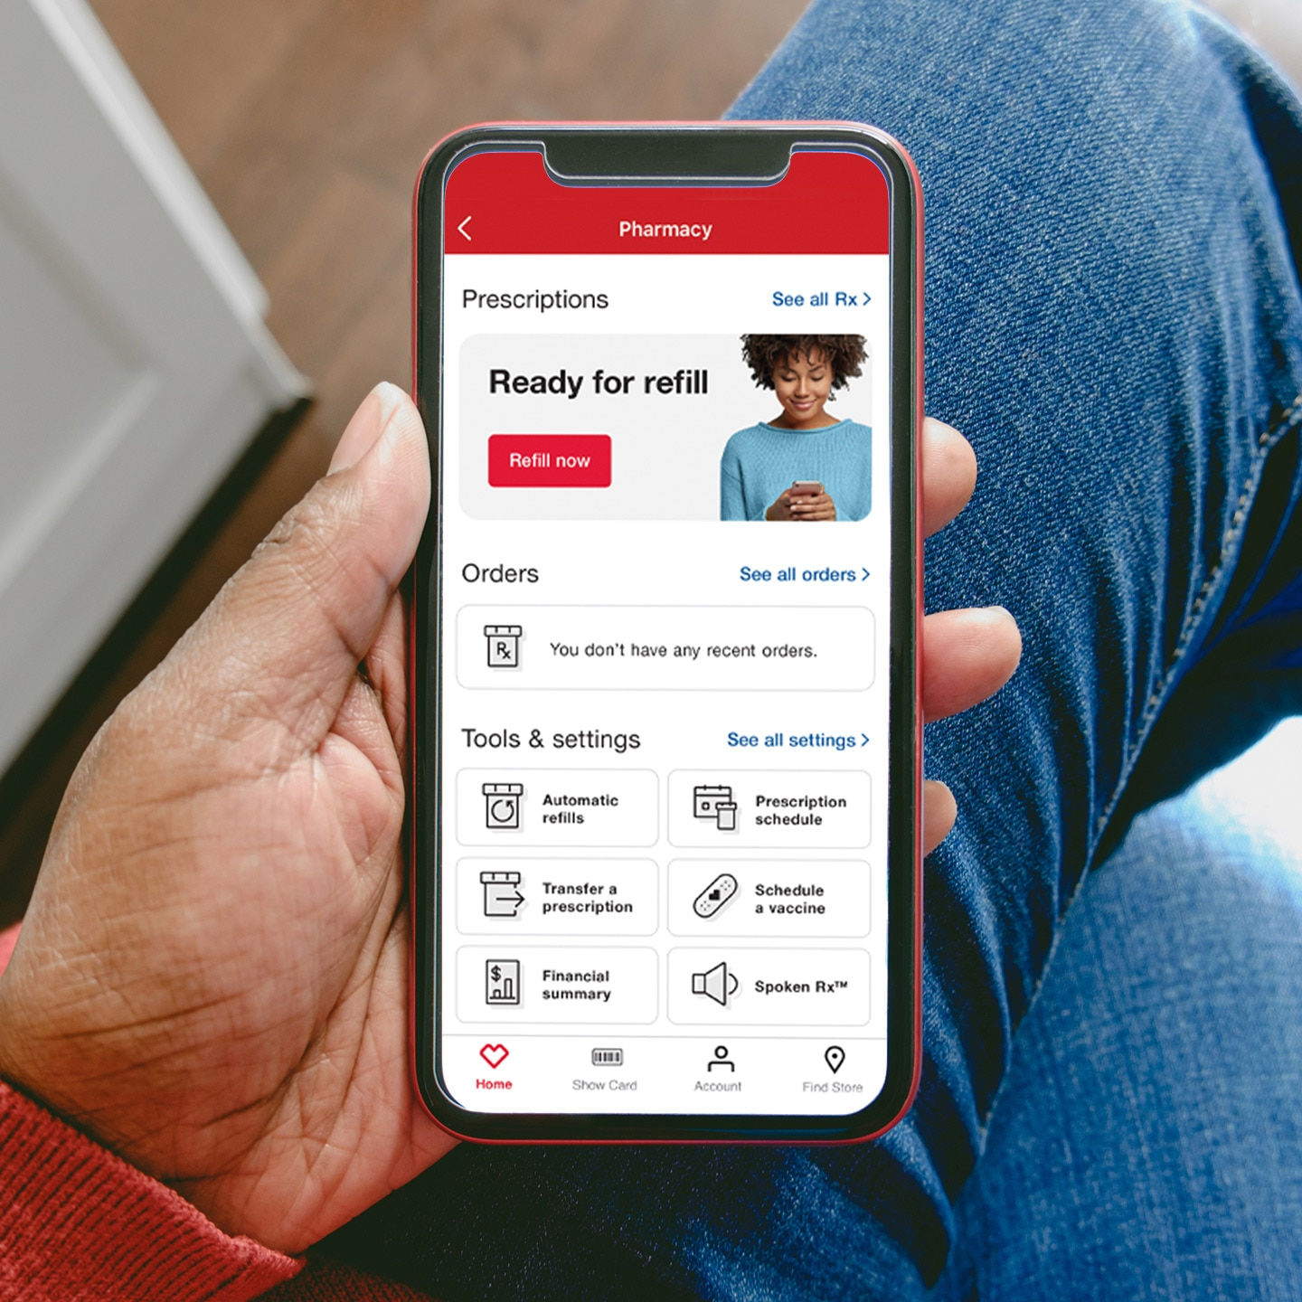
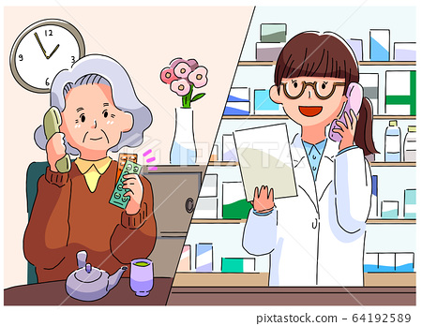
Refilling medicine
Requesting a Refill:
  In person: Bring your prescription bottle or label to the pharmacy.
  Online: Use the pharmacy's website or app.
  By phone: Call the pharmacy's refill line.
Timing: Request a refill before running out of medication.

Slide 11
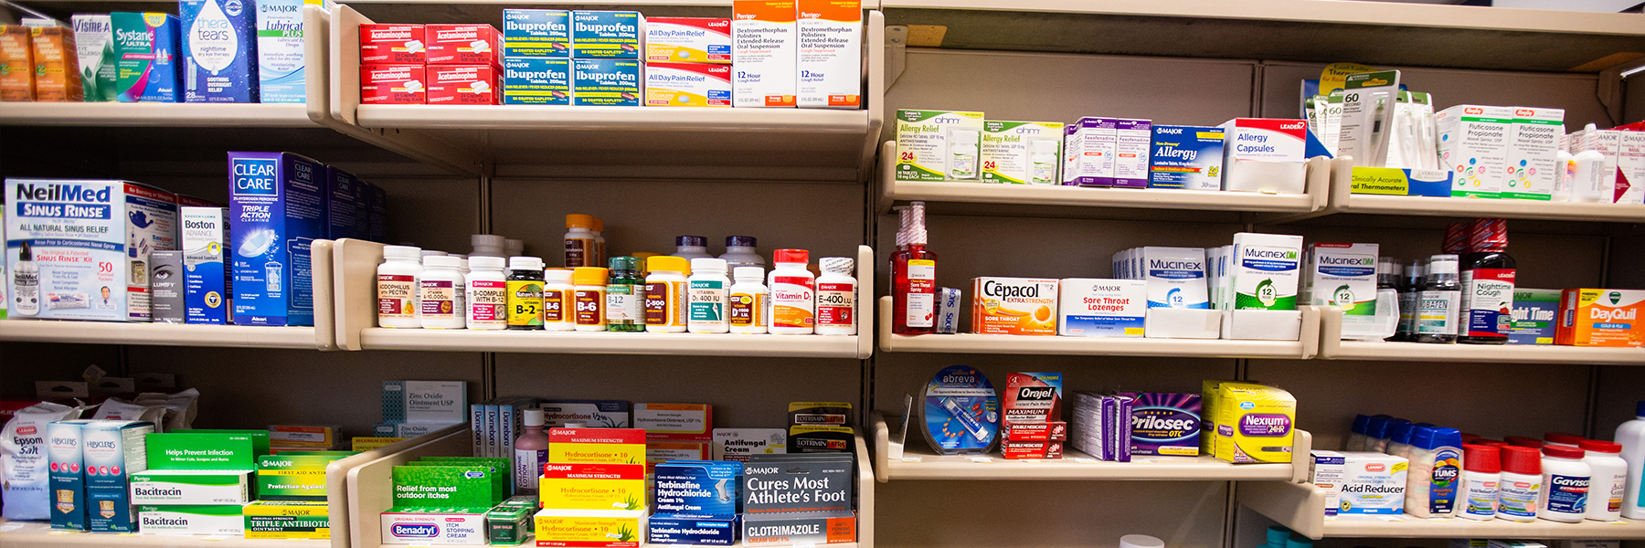
Over the counter medicine
Medications you can buy without a prescription.
Common OTC Medications:
  Pain relievers (e.g., acetaminophen, ibuprofen)
  Cough and cold remedies
  Allergy medications
  Digestive aids

Slide 12

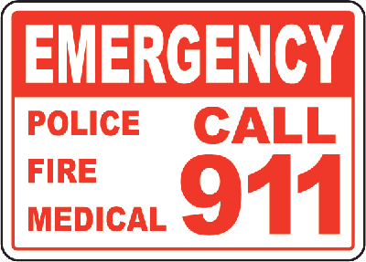
Emergency
Recognizing Emergencies:
  Severe allergic reactions (swelling, difficulty breathing)
  Overdose or poisoning
  Severe side effects (chest pain, high fever)
Immediate Actions:
  Stop taking the medication.
  Seek medical help immediately.
  Call emergency services (911) if necessary.

Slide 13
Thank you
Address: 517 E 26th St, Erie, PA 16504
Phone: (814) 452-3935

