Slide 1

hygiene practices

Slide 2

Introduction
Importance of Hygiene:
Disease Prevention: Proper hygiene helps prevent the spread of diseases and infections.
Physical Well-being: Regular hygiene practices maintain overall physical health and comfort.
Mental Health: Good hygiene can improve self-esteem and mental well-being.
Topics Covered:
The main topics that will be covered in the presentation, are daily hygiene routines, showering, oral hygiene, hand washing, and menstrual and feminine hygiene.

Slide 3
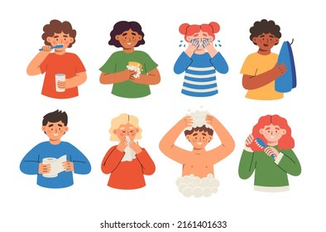
Understanding Hygiene
What is personal hygiene?
Personal hygiene is the practices and habits that you perform to maintain cleanliness and care for your body, ensuring health and well-being.
Daily Hygiene Routine
Showering or bathing
Brushing teeth
Deodorant use
Hand washing

Slide 4
Showering and Bathing
Frequency Recommendation: Shower or bathe at least once a day or as needed, especially after sweating or engaging in physical activities.
Products
Soap: Use a mild soap or body wash suitable for your skin type.
Shampoo: Choose a shampoo that suits your hair type (e.g., oily, dry, normal).
Conditioner: Optional, but beneficial for those with dry or long hair to keep it manageable and healthy.
Additional Products: Consider using a loofah or washcloth to exfoliate and remove dead skin cells.

Slide 5

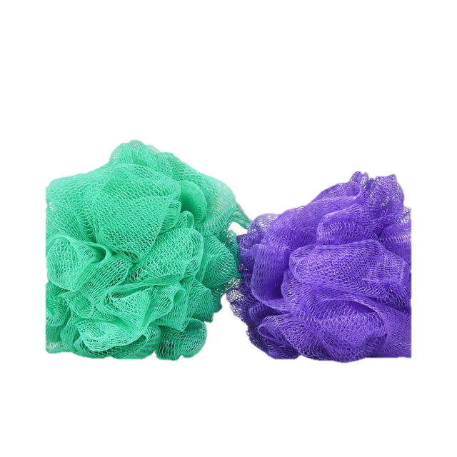

Showering and Bathing
Step-by-Step Guide:
Wet Your Body: Use warm water to thoroughly wet your body.
Apply Soap: Lather soap or body wash in your hands or on a washcloth/loofah.
Wash: Gently scrub your entire body, paying attention to areas prone to sweat and odor (e.g., underarms, feet, groin).
Rinse: Rinse off all soap thoroughly to prevent skin irritation.
Shampoo and Condition: Apply shampoo to your hair, lather, and rinse. Follow with conditioner if needed.
Dry: Pat yourself dry with a clean towel to avoid skin irritation. Ensure areas prone to moisture (e.g., underarms, groin) are thoroughly dried.
Moisturize: Apply a moisturizer after showering to keep your skin hydrated.

Slide 6
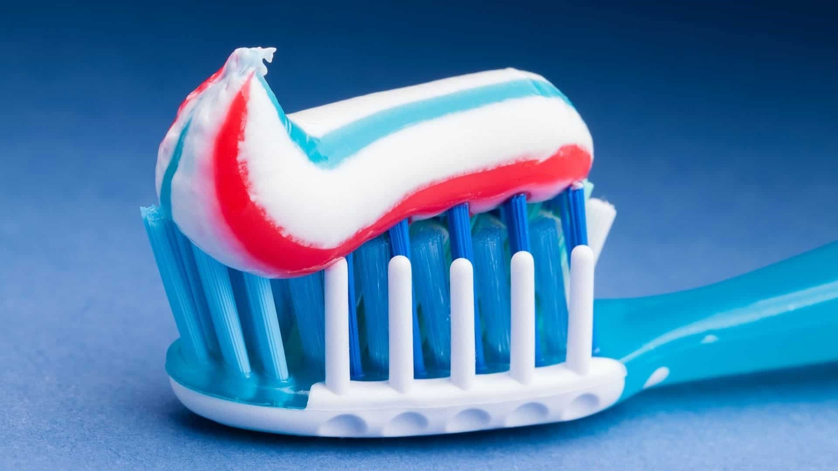
Oral Hygiene
Frequency
Brushing: Brush your teeth at least twice a day, ideally in the morning and before bedtime.
Flossing: Floss daily to remove food particles and plaque between teeth.
Mouthwash: Use an antibacterial mouthwash once a day to help reduce bacteria and freshen breath.
Products
Toothbrush: Use a soft-bristled toothbrush. Replace it every 3-4 months or sooner if the bristles are frayed.
Toothpaste

Slide 7
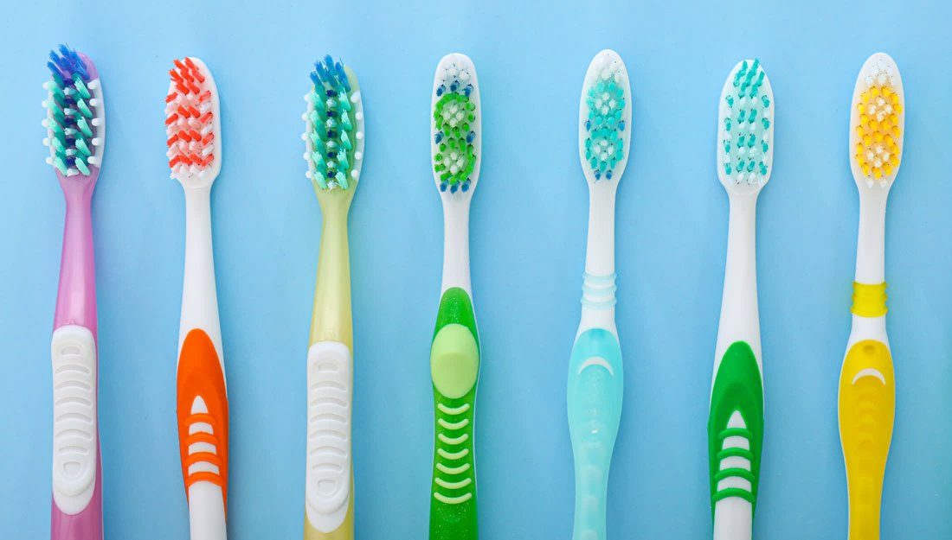
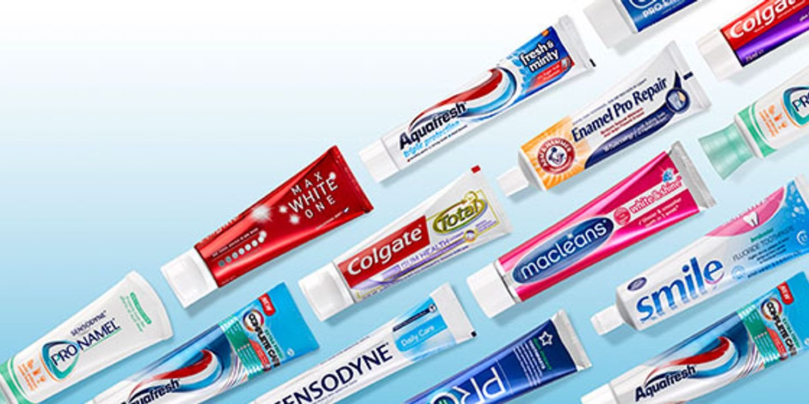
Oral Hygiene
Technique
Brushing Steps:
Apply Toothpaste: Squeeze a pea-sized amount of toothpaste onto your toothbrush.
Angle the Brush: Hold the toothbrush at a 45-degree angle to your gums.
Brush: Use gentle, circular motions to brush all surfaces of your teeth: outer, inner, and chewing surfaces.
Duration: Brush for at least two minutes.
Tongue Cleaning: Gently brush your tongue or use a tongue scraper to remove bacteria and freshen breath.
Rinse: Rinse your mouth and toothbrush thoroughly with water.

Slide 8
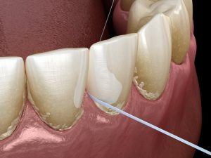
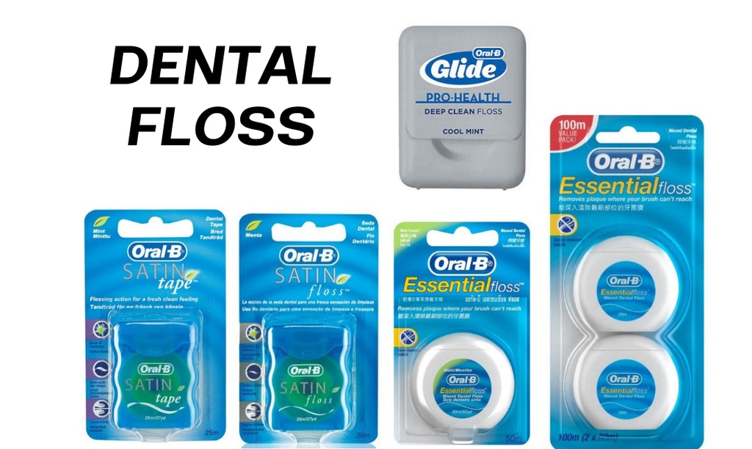
Oral Hygiene
Flossing Steps:
Use Enough Floss: Cut about 18 inches of floss.
Hold the Floss: Wrap the ends around your middle fingers, leaving about 1-2 inches to work with.
Guide the Floss: Gently slide the floss between your teeth using a back-and-forth motion.
Curve the Floss: Curve the floss around each tooth and gently slide it under the gumline.
Move to a Clean Section: Use a clean section of floss for each tooth.

Slide 9
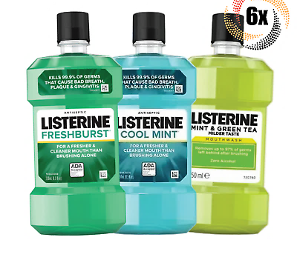
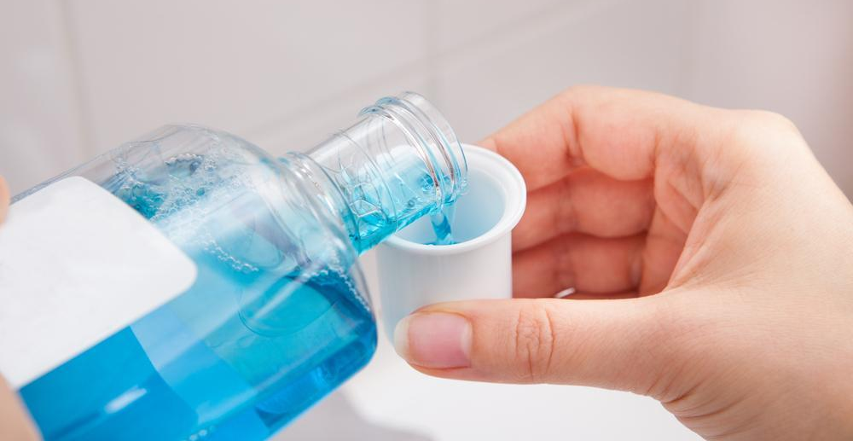
Oral Hygiene
Mouthwash Steps:
Measure: Pour the recommended amount of mouthwash into a cup.
Rinse: Swish it around your mouth for 30-60 seconds.
Spit Out: Do not swallow the mouthwash.

Slide 10
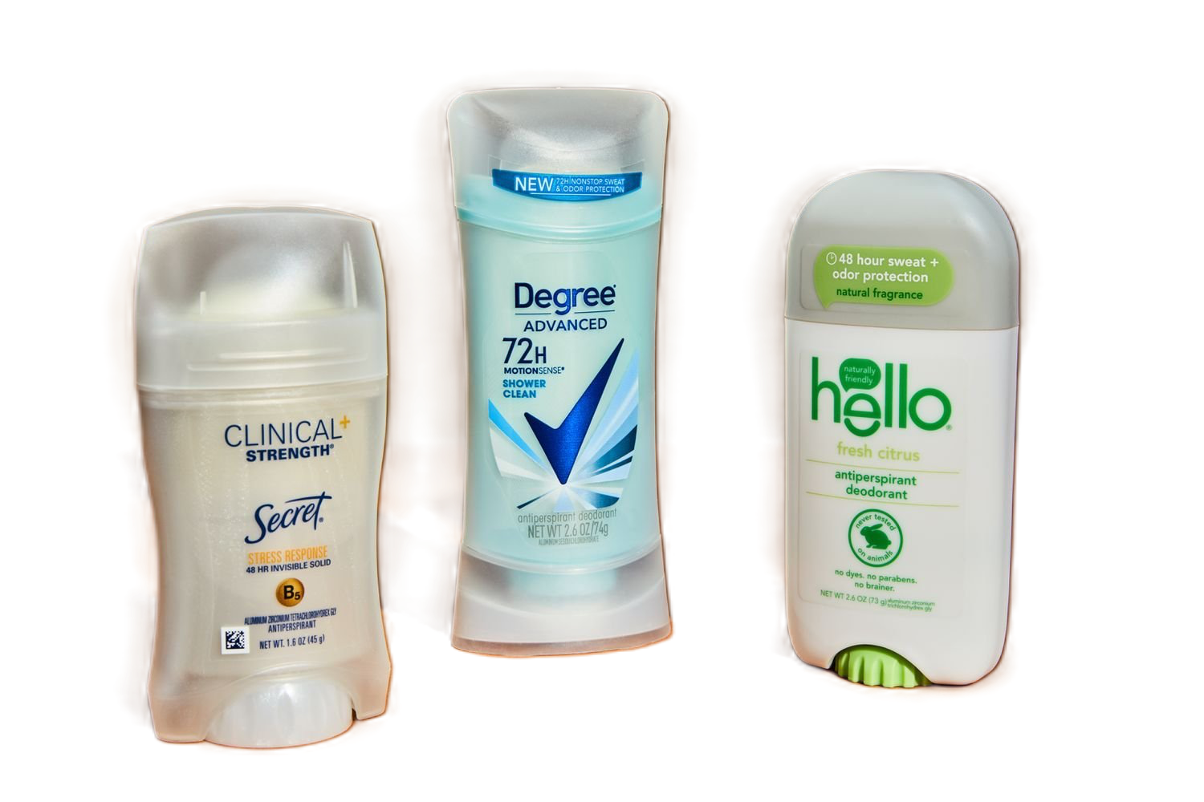
Deodorant and Antiperspirant
Purpose
Preventing Body Odor: Deodorants mask or neutralize body odor caused by sweat and bacteria.
Forms: Roll-on, stick, spray, gel, and cream.
Controlling Sweat: Antiperspirants reduce the amount of sweat produced by blocking sweat glands.
Similar to deodorants – roll-on, stick, spray, gel, and cream.

Slide 11
Deodorant and Antiperspirant
Application
When to Apply: Best applied to clean, dry skin. Ideally, apply after showering and drying off.
How to Apply:
Roll-on and Stick: Glide over underarms evenly. Ensure full coverage but avoid over-application to prevent residue.
Spray: Hold the can 6 inches away from the underarm and spray for 2-3 seconds.
Gel and Cream: Squeeze a small amount and rub it into the underarm area until fully absorbed.
Frequency: Apply once or twice a day, depending on individual needs and activity levels.

Slide 12

Hand Hygiene
Disease Prevention: Proper hand hygiene is the most effective way to prevent the spread of infections and illnesses.
Community Health: Reduces the transmission of germs to others, protecting both personal and public health.
Everyday Activities: Critical for maintaining hygiene after activities such as using the restroom, handling food, or coming into contact with potentially contaminated surfaces.

Slide 13
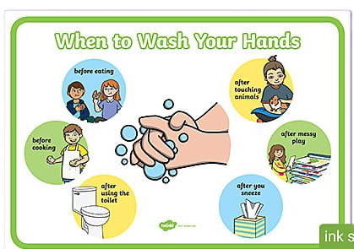

Hand Hygiene
Before:
Eating or preparing food
After:
Using the restroom
Handling raw meat, poultry, or fish
Touching garbage
Blowing your nose, coughing, or sneezing
Caring for someone who is sick
Changing diapers or cleaning up a child who has used the toilet
Handling pets or pet waste
Treating wounds or giving medicine
Touching a sick or injured person

Slide 14
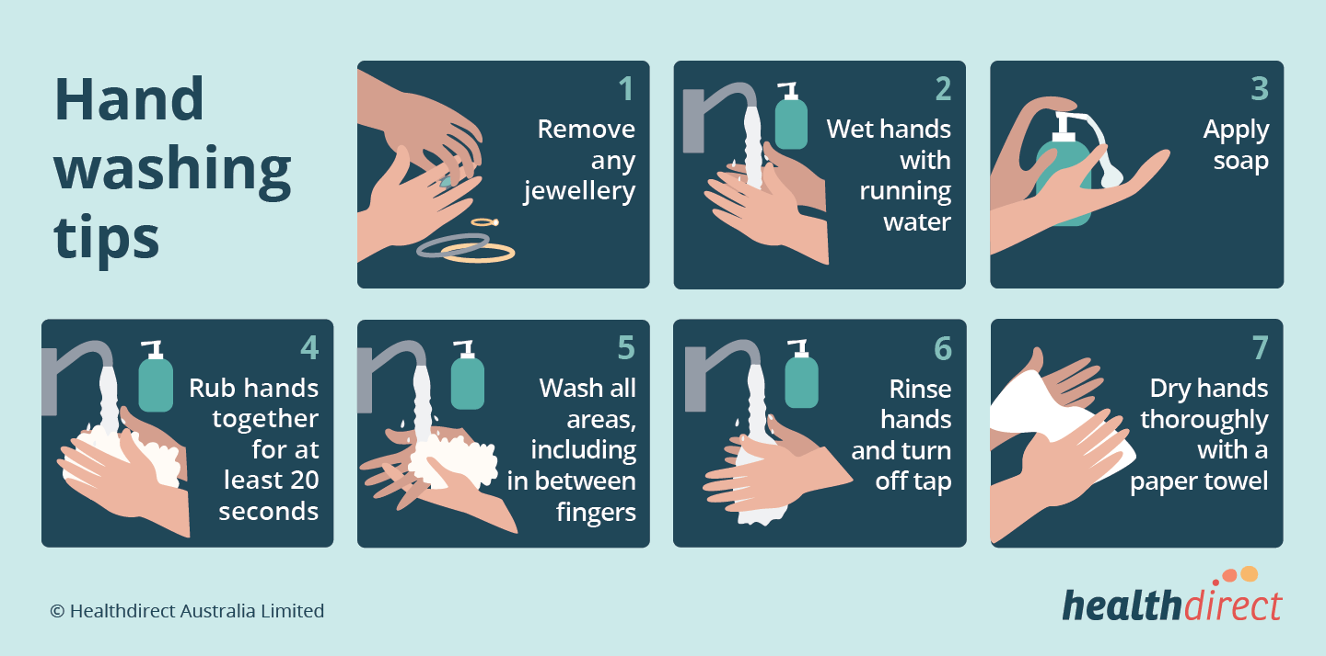
Hand Hygiene
Step-by-Step Guide:
Wet Hands: Wet your hands with clean, running water (warm or cold), and apply soap.
Lather: Rub your hands together to lather the soap. Make sure to lather the backs of your hands, between your fingers, and under your nails.
Scrub: Scrub your hands for at least 20 seconds. Hum the "Happy Birthday" song from beginning to end twice for a time reference.
Rinse: Rinse your hands well under clean, running water.
Dry: Dry your hands using a clean towel or air dry them.

Slide 15
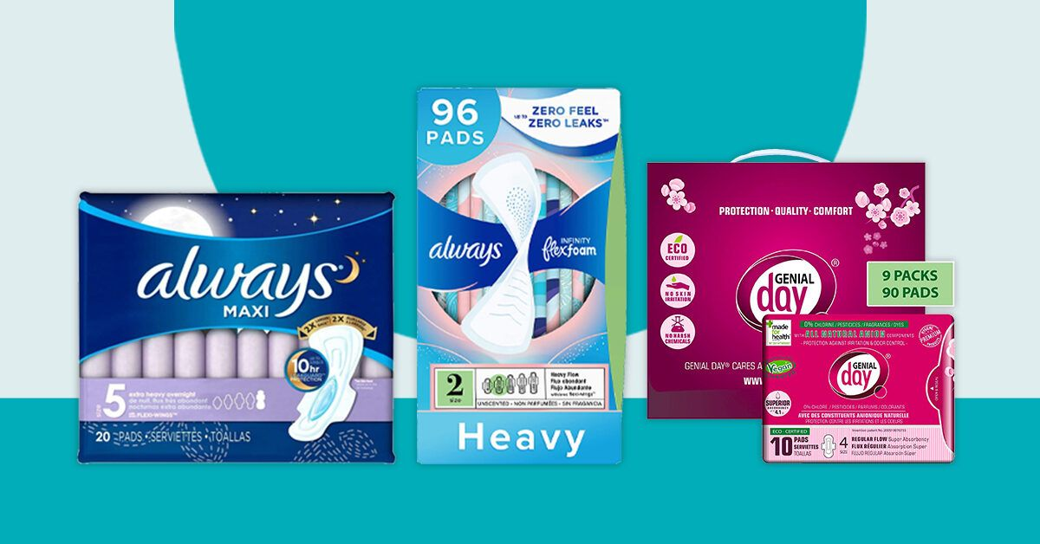
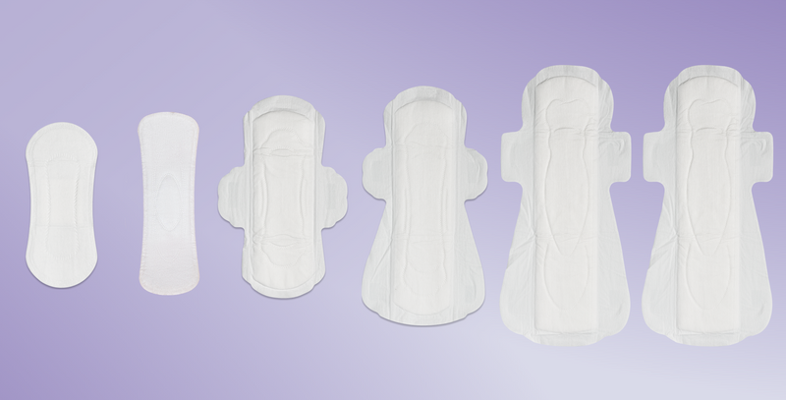
Feminine Hygiene
Types Available:
Pads: absorbent items worn in underwear to catch menstrual blood.
Peel off the adhesive backing strip.
Place the pad sticky-side down on the center of your underwear.
If the pad has wings, fold them around the sides of your underwear for extra security.
Changing:
Change the pad every 4-8 hours or when it feels wet.
Wrap the used pad in its wrapper or toilet paper and dispose of it in a trash bin (not in the toilet).

Slide 16
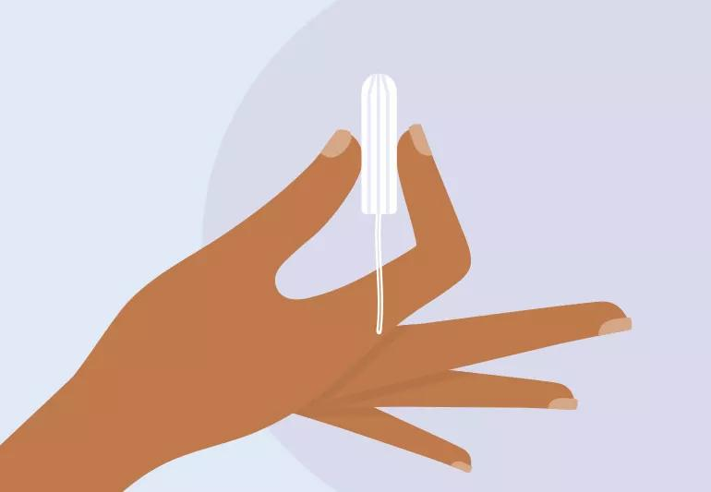
Feminine Hygiene
Tampons are small, cylindrical products inserted into the vagina to absorb menstrual blood. They are made of absorbent material, usually cotton.
Preparation: Wash your hands thoroughly.
Positioning: Sit or stand in a comfortable position (e.g., sitting on the toilet or standing with one leg up).
Inserting with an Applicator:
Hold the applicator with your thumb and middle finger.
Gently insert the tip into your vagina at a slight angle.
Push the inner tube of the applicator until it is fully inside.
Remove the applicator, leaving the tampon inside with the string hanging outside.

Slide 17
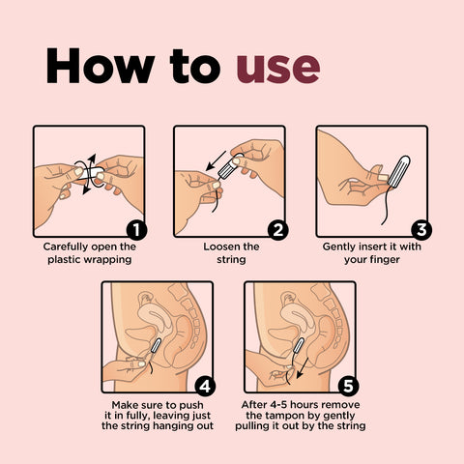
Feminine Hygiene
How to Remove:
Preparation: Wash your hands.
Relaxing: Find a comfortable position and relax your muscles.
Pulling: Gently pull the string downward and forward to remove the tampon.
Disposal: Wrap the used tampon in toilet paper and dispose of it in a trash bin (not in the toilet).
Changing Frequency: Change the tampon every 4-8 hours or sooner if it feels full.

Slide 18
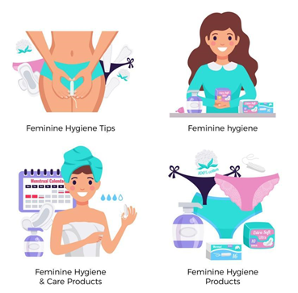

Intimate Hygiene
Daily Cleaning:
Importance: Maintaining cleanliness of the genital area is crucial for preventing infections and maintaining overall health.
Technique:
Water and Mild Soap:
Use lukewarm water to wash the genital area daily.
Use a mild, unscented soap. Avoid d scented products, as they can cause irritation.
Method:
Gently wash the external area
Avoid inserting soap or water inside
Rinse thoroughly to remove all soap.
Drying:
Pat the area dry with a clean, soft towel.
Avoid rubbing, which can cause irritation.
Ensure the area is completely dry to prevent bacterial growth.

Slide 19

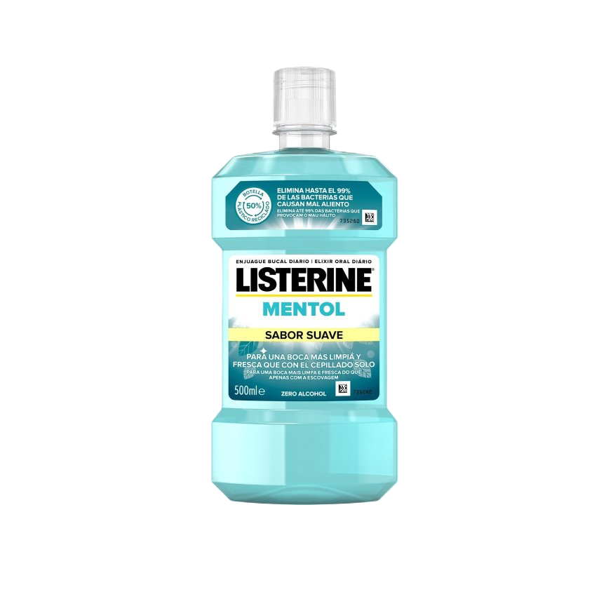
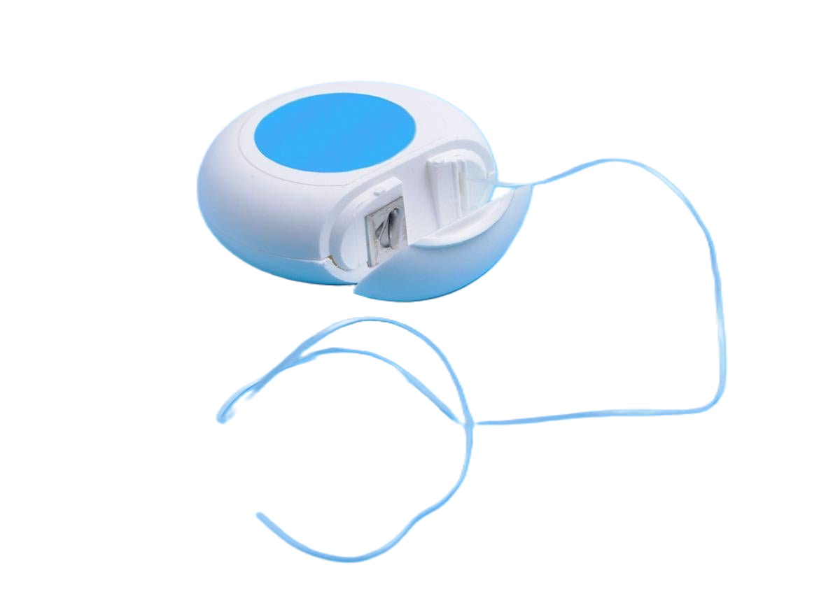
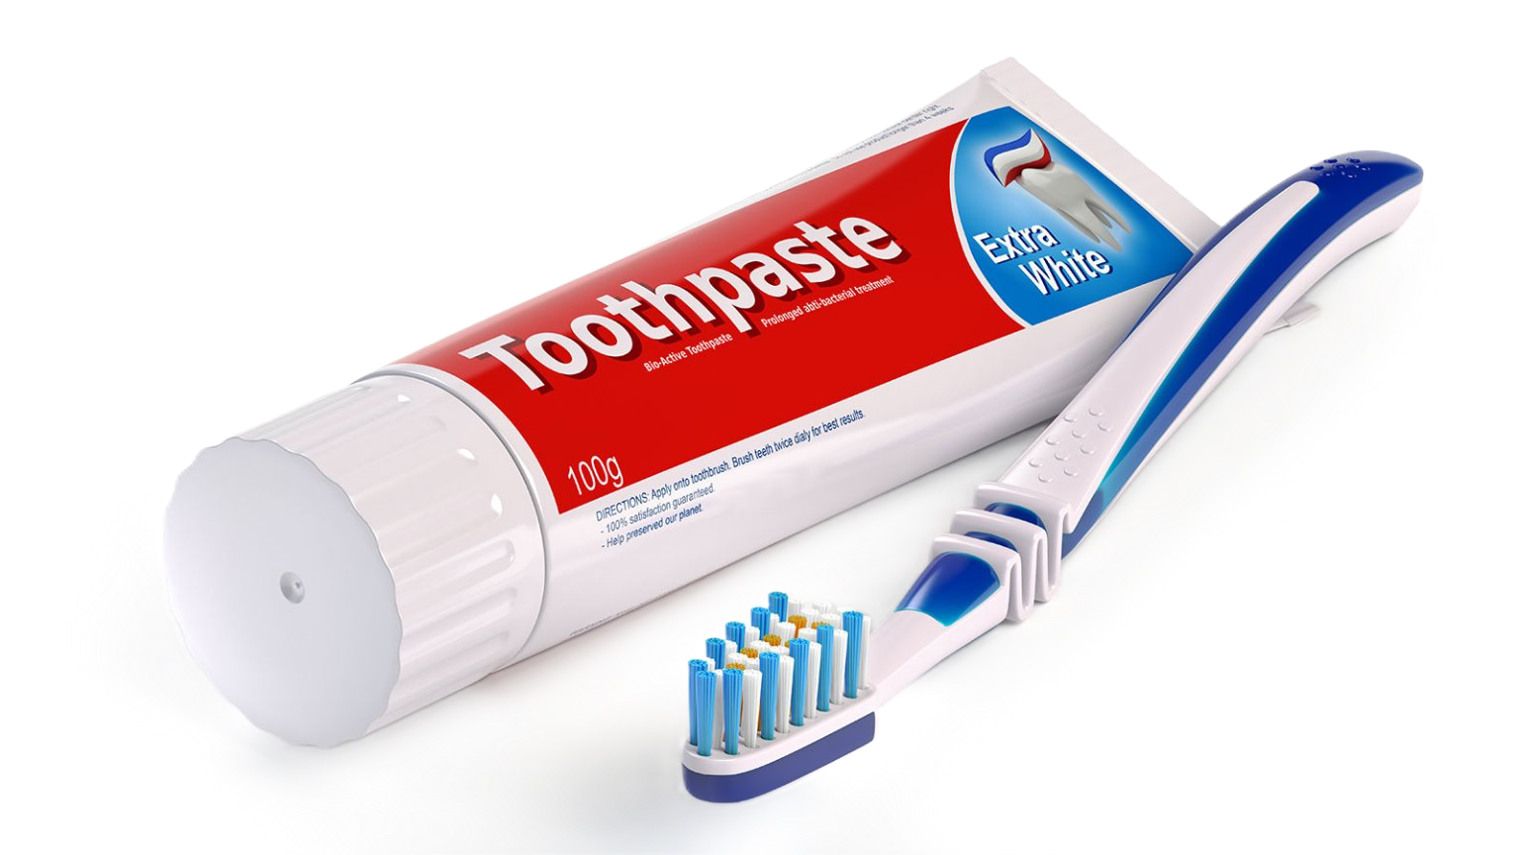
Things To Buy at the Store

Slide 20
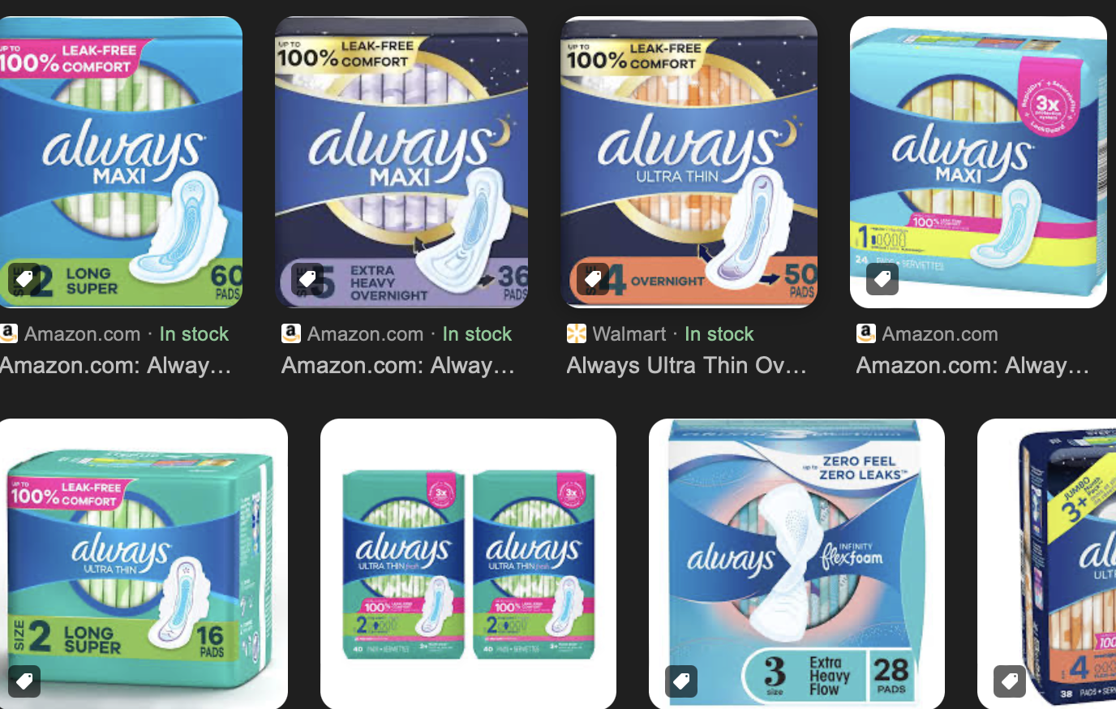
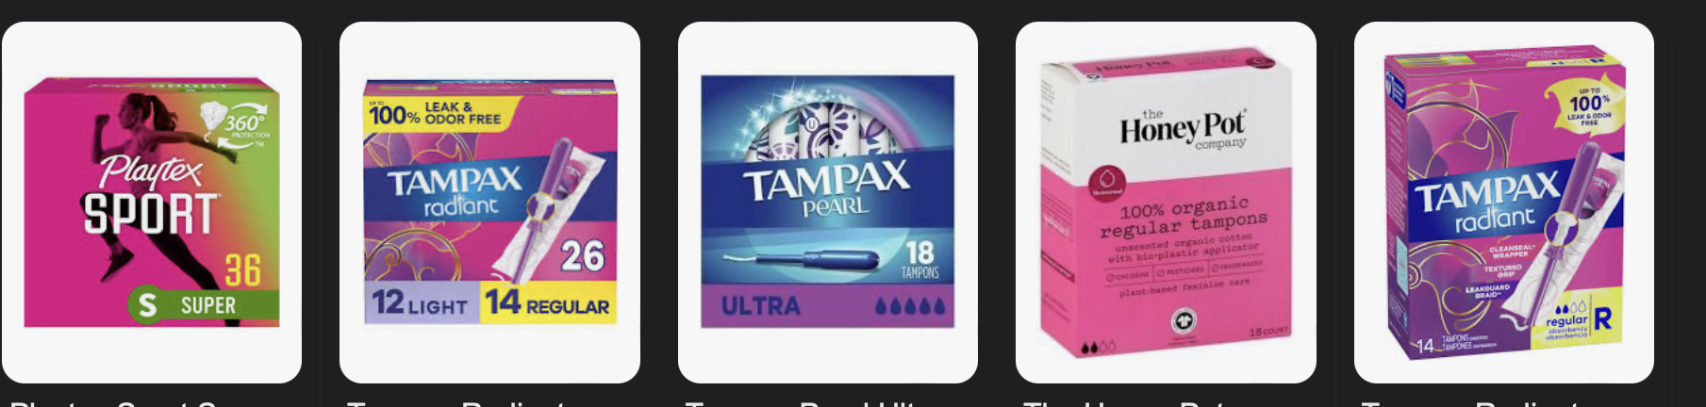
Things To Buy at the Store

Slide 21
Thank you!
Questions?
Address: 517 E 26th St, Erie, PA 16504
Phone: (814) 452-3935

